Slide 1
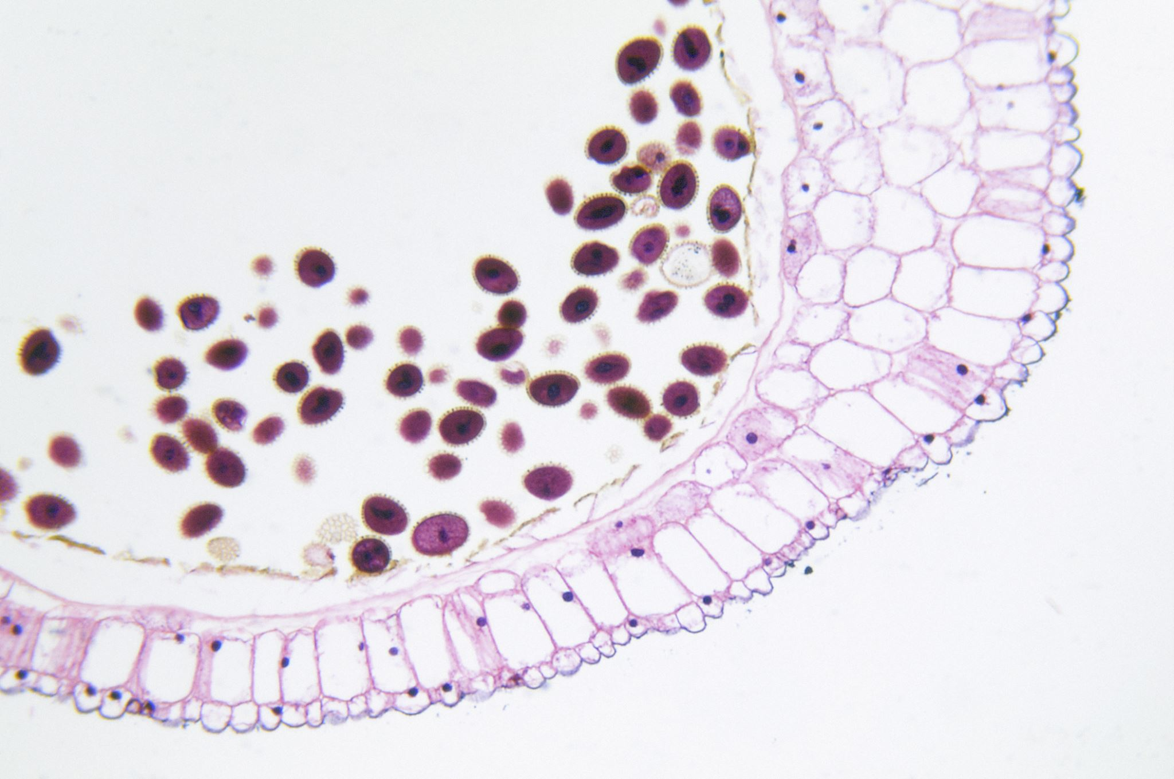
The Gastrointestinal System
Gastric, Duodenal & Small Intestinal Disorders
PAS 523 Clinical Medicine II
Summer 2026
Dr. Melanie Barriffe, DMSc, MS, PA-C

Slide 2
Instructional Learning Objectives-Module N
#3. Explain the epidemiology, etiology, pathophysiology, clinical presentation, diagnostic findings, and treatment of Diseases of the Stomach and Duodenum including:
Gastritis, Gastroparesis, Peptic ulcer disease, Pyloric stenosis, Gastrointestinal Bleeding
#4. Explain the epidemiology, etiology, pathophysiology, clinical presentation, diagnostic findings, and treatment of Diseases of the Small Intestine including:
Appendicitis, Celiac disease, Intussusception, Obstruction, Polyps

Slide 3

PANCE Question
GI

Slide 4
PANCE Question
A 28-year-old female presents to the emergency department complaining of right lower quadrant abdominal pain that has been present for the past 5 days. She has experienced anorexia, nausea, and subjective fevers.
On PE, her temperature is 38.6°C (101.5°F), heart rate is 108 bpm, and blood pressure is 112/74 mmHg. Abdominal examination reveals a tender palpable, firm mass in the right lower quadrant with localized guarding.
A CT scan of the abdomen and pelvis with IV contrast demonstrates a ruptured appendix with a well-circumscribed, 5.0 cm periappendiceal abscess.

Slide 5
Which of the following is the most appropriate initial management for this patient?
A) Immediate open appendectomy
B) Immediate laparoscopic appendectomy
C) Intravenous antibiotics and CT-guided percutaneous drainage
D) Diagnostic laparoscopy with extensive peritoneal lavage
E) Discharge home with a 14-day course of oral antibiotics

Slide 6

Mechanisms Review
A&P/Pathophysiology

Slide 7
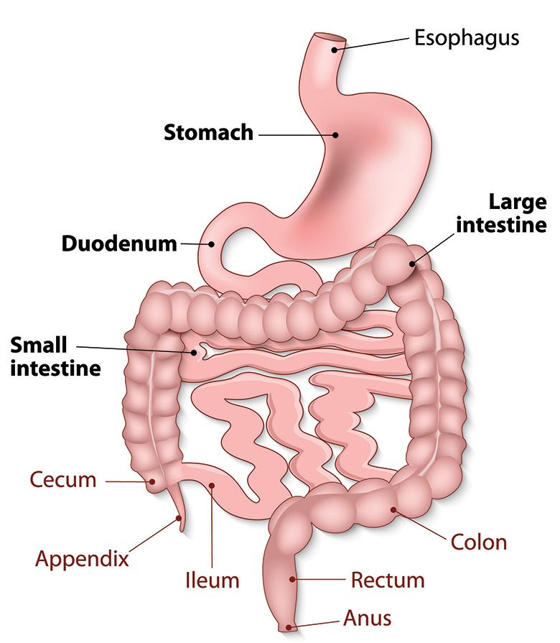
Review of the Stomach/Duodenum and Small Intestine Anatomy

Slide 8
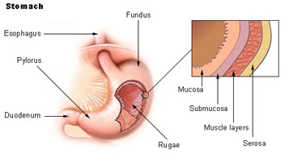
Lining of the Stomach

Slide 9
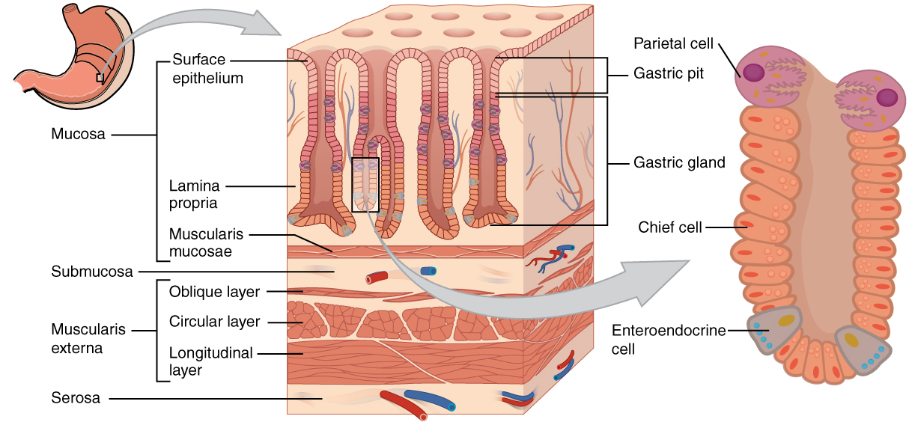

Slide 10
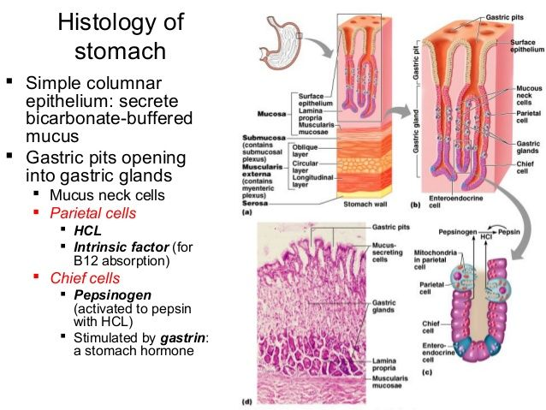

Slide 11
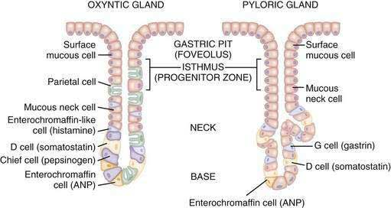
MIDGUT — MICROANATOMY
Gastric Mucosa: Specialized Cells
Mucous cells — protective mucus & bicarbonate
Parietal cells — HCl + intrinsic factor
Chief cells — pepsinogen → pepsin: begins protein digestion
G cells (antrum) — gastrin
GI System — Anatomy & Physiology
14 / 46

Slide 12
Special Cells in the Gastric Mucosa
Mucus cells:
1. Foveolar (surface mucus) cells – cover the epithelial surface of the stomach.
2. Mucus neck cells – at the neck (upper portion) of the gastric pit/gland.
Function: These cells secrete mucus and bicarbonate ions to help protect lining from autodigestion by HCl and pepsin.

Slide 13
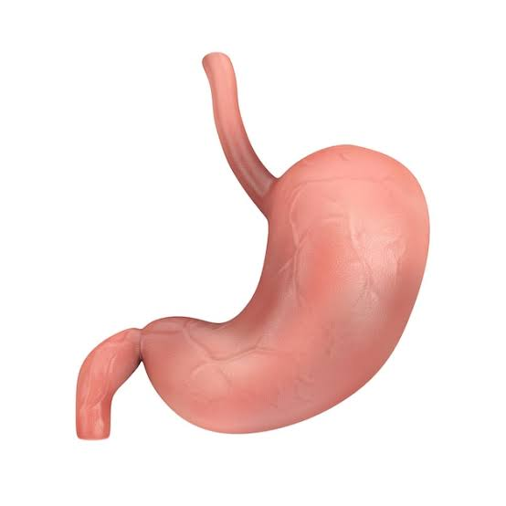
Special Cells in the Gastric Mucosa
Chief cells:
Located primarily in the fundus of the stomach; stimulated by the vagus nerve and gastrin.
Chief cells secrete pepsinogen.
Pepsinogen is a proenzyme (inactive form) of pepsin.
Pepsinogen is converted to pepsin by HCl (acidic environment).
Pepsin digests proteins.

Slide 14

Mystery Case

Slide 15
Mystery Case
Ms. Riding Hood is a 24 year old female with no significant PMH. She comes to the clinic today with burning epigastric abd pain, nausea, vomiting, bloating, early satiety for the past 3 weeks.
What disease does Ms. Hood have?

Slide 16
Diseases of the Stomach and Duodenum
Gastritis
Gastroparesis
Peptic ulcer disease
Pyloric stenosis
Gastrointestinal Bleeding

Slide 17
Gastritis
Medical Terminology:
Gastro-Meaning: Pertaining to the stomach.
-itis (Suffix) Meaning: inflammation

Slide 18
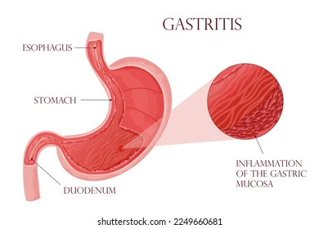

Slide 19
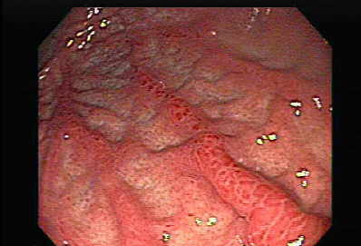
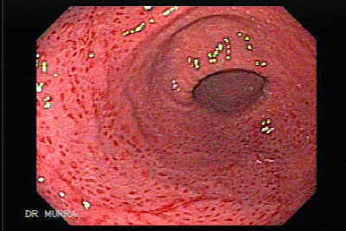
Gastritis

Slide 20

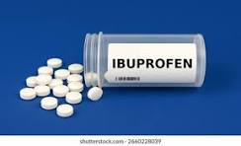
Gastritis
Inflammation of the gastric mucosa confirmed histologically, not simply endoscopic redness.
A distinction is between true gastritis (characterized by inflammatory cell infiltrate) vs. reactive gastritis (e.g., from NSAIDs, bile reflux, or alcohol),
True gastritis means the stomach lining is inflamed because white blood cells have invaded the tissue.
Reactive gastritis looks like irritation, but caused by mostly from NSAIDs, alcohol, or stomach acid rather than immune cells. Instead of inflammation, it causes overgrowth of the stomach lining cells, extra smooth muscle, and congested blood vessels
In short: True gastritis is inflammation from immune cells, while reactive gastritis is injury and overgrowth caused by irritants (like NSAIDs or alcohol) with very little inflammation.

Slide 21

Epidemiology
Global Burden
Gastritis and duodenitis affects approximately 27.2 million individuals globally
Prevalence is higher in females
Increases with age, peaking in the fifth decade of life.
Prevalence rates particularly in Sub-Saharan Africa and parts of Asia.
Notes:
1.Global, Regional, and National Burden of Gastritis and Duodenitis From 1990 to 2021 With Projections to 2050: A Systematic Analysis of the Global Burden of Disease Study 2021.
International Journal of Medical Sciences. 2025. Wang L, Jiang W, Li H.

Slide 22
Etiology
H. (Helicobacter) pylori gastritis: The most common cause of chronic gastritis worldwide. It causes two patterns:
Antral-predominant → acid hypersecretion → duodenal ulcers
Pangastritis → gastric atrophy → reduced acid → gastric cancer risk
Autoimmune gastritis (AIG): Autoantibodies against parietal cells (produce HCL) and protein intrinsic factor ( all within the stomach lining)→ corpus-predominant atrophy with antral sparing → malabsorption of vitamin B12, iron deficiency, and pernicious anemia
(Type 1 Diabetes or thyroid disease)
NSAID/chemical gastropathy: COX-1 inhibition (NSAIDS-Ibuprofen, aspirin, naproxen) reduces prostaglandins → impaired mucosal blood flow, mucin production, and epithelial repair
Other causes: Crohn's disease (focally enhanced gastritis), lymphocytic gastritis, eosinophilic gastritis, bile reflux

Slide 23
Gastritis
Pathophysiology — Mucosal Defense
The gastric mucosal barrier relies on three key elements:
(1) tight junctions between epithelial cells (forms seals between surface cells),
(2) a thick mucus-bicarbonate layer coating
(3) prostaglandin-mediated mucosal blood flow and repair. (Good blood flow and repair driven by hormones called prostaglandins).
How Damage Happens:
H. pylori bacteria break down the cell seals and cause long-term inflammation.
NSAIDs (like ibuprofen) block protective prostaglandins (impair prostaglandin synthesis via COX-1 inhibition), stopping the stomach from repairing and protecting itself.

Slide 25
MIDGUT — MICROANATOMY
Gastric Mucosa: Specialized Cells
Mucous cells — protective mucus & bicarbonate
Parietal cells — HCl + intrinsic factor
Chief cells — pepsinogen → pepsin: begins protein digestion
G cells (antrum) — gastrin
GI System — Anatomy & Physiology
14 / 46

Slide 26
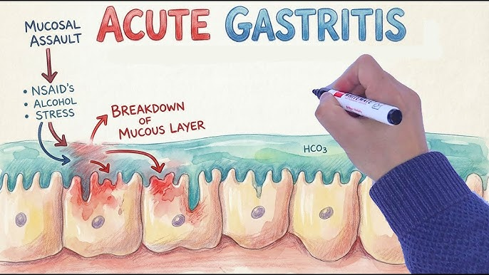
Acute Gastritis Pathophysiology

Slide 27
Clinical Presentation
Symptoms are nonspecific
Dyspepsia: Upper abdominal pain or a burning feeling after eating
Epigastric pain
Abdominal distension
Postprandial fullness - an uncomfortable feeling of being too full for a long time after eating a normal meal.
Many patients are asymptomatic.
Autoimmune gastritis may present with macrocytic anemia, neurologic symptoms (B12 deficiency), or iron deficiency anemia from achlorhydria ( absence of HCL in gastric secretions) impairing iron absorption).
Notes:
Vitamin B12 deficiency symptoms commonly include extreme fatigue, numbness or tingling in the hands and feet, and a sore, red tongue.

Slide 28
Diagnosis
Histology is the gold standard — Looking at stomach tissue under a microscope (histology) is the most reliable method.
Endoscopy (using a small camera) and takes specific tissue samples from 5 different areas of the stomach (following the Sydney protocol: 2 from the lower part, 2 from the upper part, and 1 from the bend in the middle)
H. pylori testing:
Noninvasive (preferred initial): urea breath test or stool antigen test — both require holding PPIs (Proton Pump Inhibitors-OTC-omeprazole/Prilosec, Esomeprazole/Nexium, etc) for ≥2 weeks and antibiotics for ≥4 weeks
Invasive (at endoscopy): rapid urease test, histology, culture
Autoimmune gastritis: anti-parietal cell antibodies, anti-intrinsic factor antibodies, elevated gastrin, low pepsinogen I, B12 levels

Slide 29
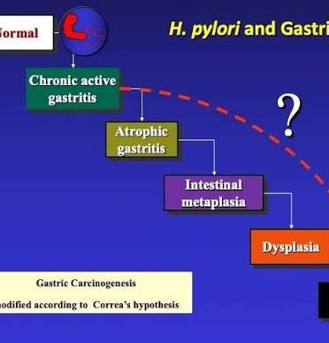
The Correa Cascade
The Step-by-Step Progression: Stomach cancer usually develops very slowly through a predictable chain of changes in the stomach lining:
Normal tissue
Chronic gastritis (long-term inflammation)
Atrophic gastritis (the stomach lining thins out and shrinks)
Intestinal metaplasia (stomach cells transform to look like intestine cells)
Dysplasia (cells start turning abnormal and pre-cancerous)
Gastric adenocarcinoma (full-blown stomach cancer)

Slide 30
The Correa Cascade Staging
OLGA staging (Operative Link on Gastritis Assessment) stratifies cancer risk:
stages III–IV carry significantly elevated neoplasia risk
while stages 0–II have near-zero risk.

Slide 31
Complications
Peptic ulcer disease (especially with H. pylori or NSAIDs)
Gastric adenocarcinoma: chronic atrophic gastritis increases risk:
H. pylori is responsible for majority of noncardiac gastric cancers
Type 1 gastric neuroendocrine tumors (NETs): form when overactive stomach hormones (caused by autoimmune gastritis) cause certain cells to multiply too much.
Pernicious anemia / B12 deficiency: advanced autoimmune gastritis

Slide 32
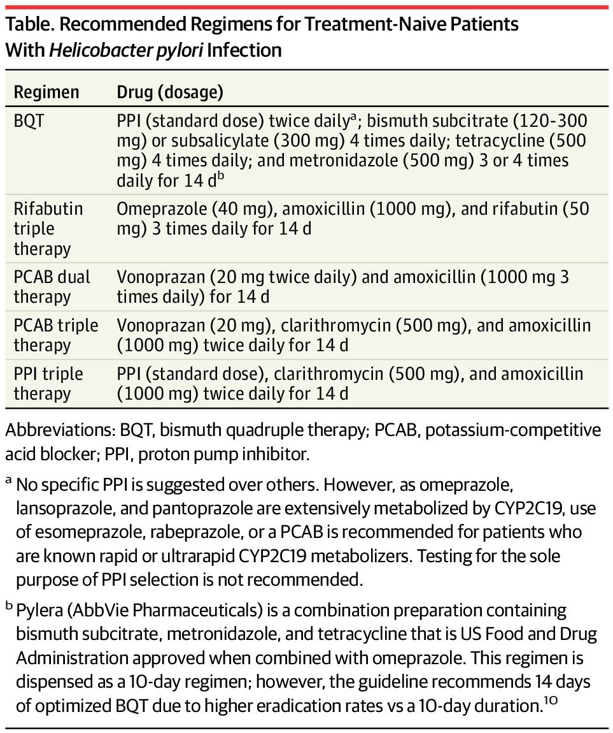
H. pylori eradication — Per the ACG guideline, for treatment-naive patients with unknown susceptibility
Notes:
ACG Guideline on Treatment of Helicobacter pylori: New Recommendations… Will Practice Change? - American College of Gastroenterology

Slide 33
Treatments
First-line preferred: Bismuth quadruple therapy (BQT) × 14 days — PPI + bismuth + tetracycline + metronidazole
Alternatives: Rifabutin triple therapy (omeprazole + amoxicillin + rifabutin) × 14 days, or PCAB dual therapy (vonoprazan + amoxicillin) × 14 days
**Confirm eradication: ≥4 weeks after completing therapy with urea breath test or stool antigen
Notes:
]

Slide 34
Treatments continued
Acid suppression: PPIs are the mainstay for symptom relief and mucosal healing in all forms of gastritis/gastropathy.
NSAID gastropathy: Discontinue the offending agent if possible

Slide 35
Dyspepsia Workup — When to Scope
The ACG/CAG guideline recommends EGD (esophagogastroduodenoscopy,) for patients ≥60 years with new-onset dyspepsia.
For patients <60, a test-and-treat strategy for H. pylori (noninvasive testing → eradication if positive) is preferred over endoscopy, even in the presence of alarm features, given the very low malignancy risk in this age group.
Alarm features (weight loss, GI bleeding/anemia, dysphagia, persistent vomiting)
Notes:
Dyspepsia: Upper abdominal pain or a burning feeling after eating

Slide 36
Gastroparesis
Medical Terminology:
Gastro-Meaning: Pertaining to the stomach.
Paresis (Root word) Meaning: Slight or partial paralysis / weakness.

Slide 37
Gastroparesis
Definition and Epidemiology
Delayed gastric emptying in the absence of mechanical obstruction, with nausea, vomiting, early satiety, postprandial fullness, bloating, and abdominal pain.
Prevalence is with a strong female predominance.
Etiology
Big Three" P
Idiopathic (unknown) — the largest etiologic group, where no clear reason is found.
Diabetic — accounts for ~25% of cases; caused by nerve damage and high blood sugar harming the stomach's natural pacemaker cells (interstitial cells of Cajal)
Postsurgical — vagal nerve injury (e.g., after fundoplication, bariatric surgery)
Other causes: postinfectious (viral), medications (opioids, GLP-1 receptor agonists, anticholinergics), connective tissue disorders (scleroderma), Parkinson disease, amyloidosis

Slide 38
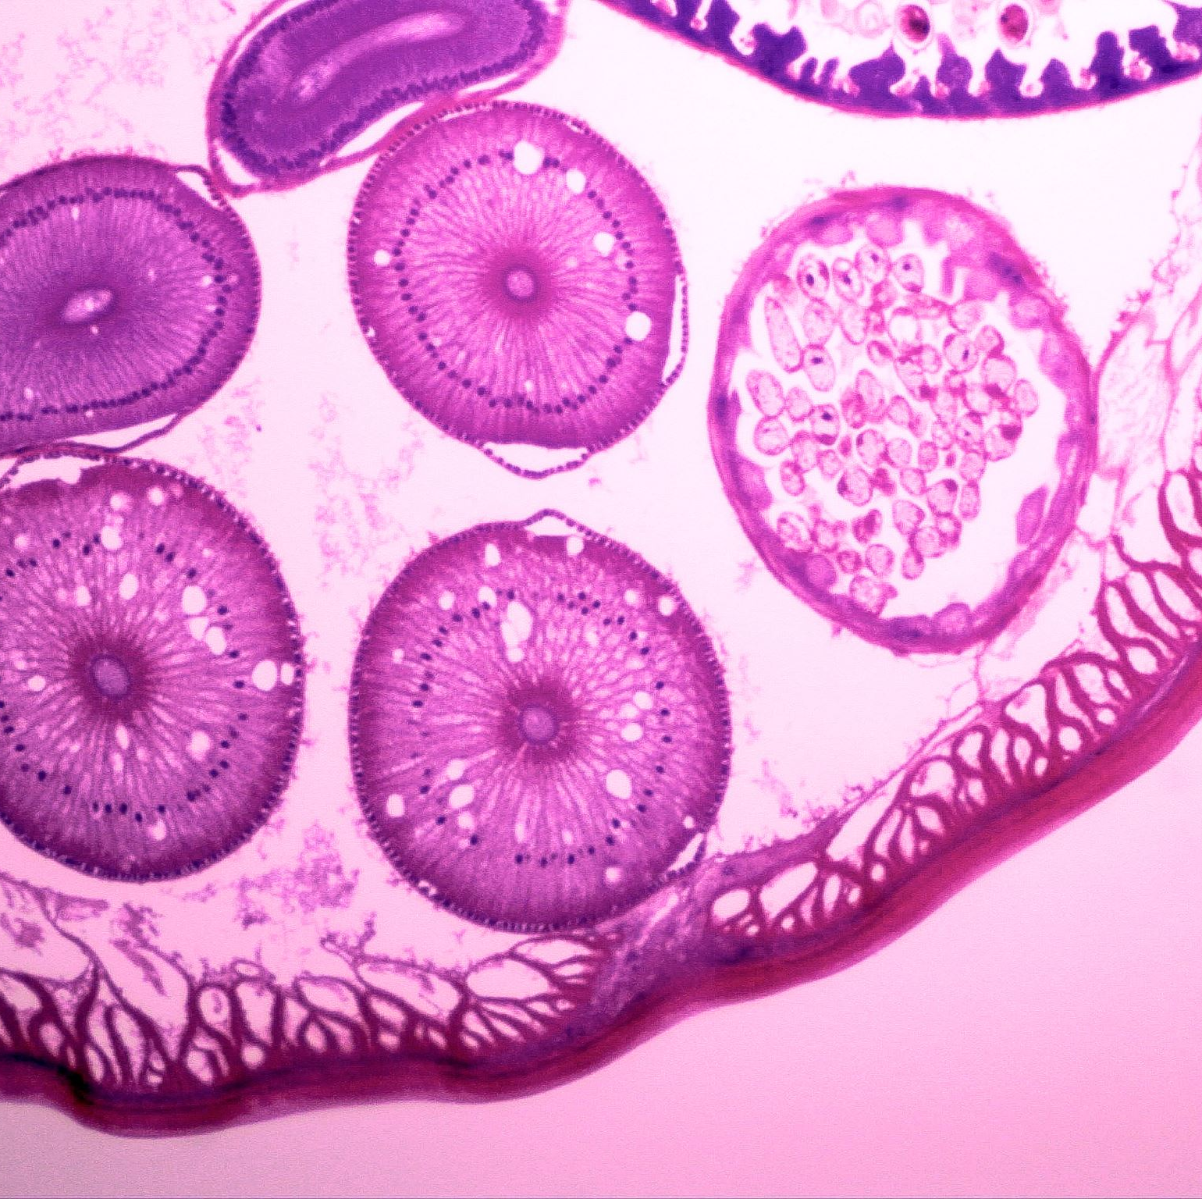
Pathophysiology
What happens inside the stomach:
Cell Damage: Loss of the stomach's natural pacemaker cells (interstitial cells of Cajal), alongside immune system over-activation (inflammation), cell stress, and nerve damage.
The Result:
The lower stomach stops moving properly, pyloric dysfunction, the stomach can't stretch to hold food, and electrical dysrhythmias
Notes:
What’s going on??

Slide 39
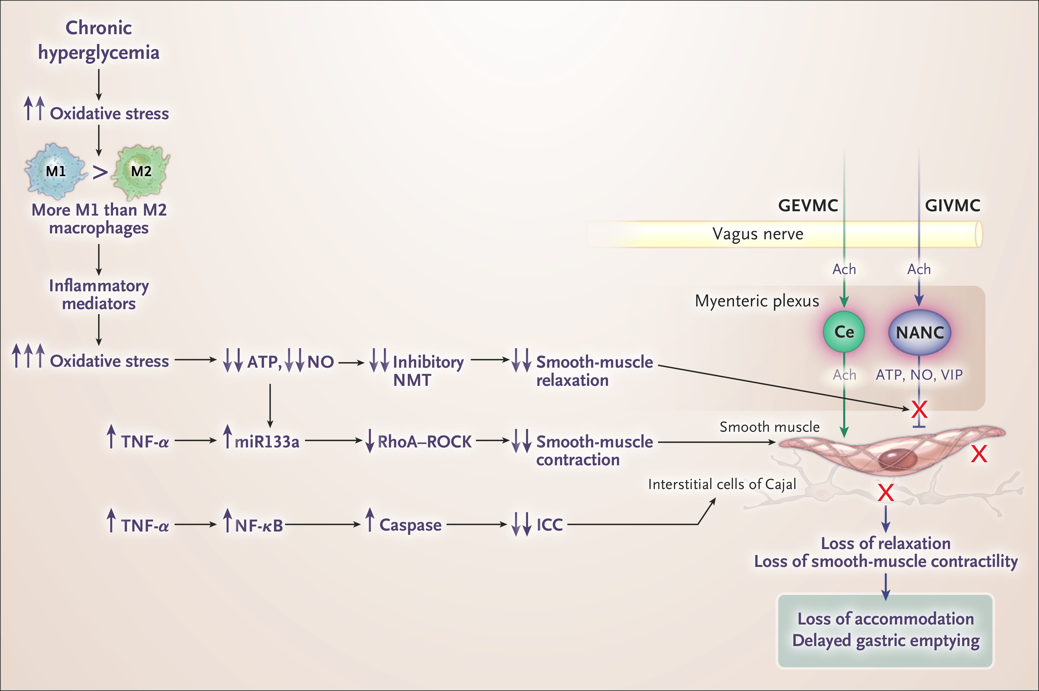
Pathophysiological cascade from hyperglycemia to gastroparesis in diabetic patients
Notes:
Gastric Emptying Abnormalities in Diabetes Mellitus. N Engl J Med. May 5, 2021.
Used under license from The New England Journal of Medicine.
Get a better pic

Slide 40
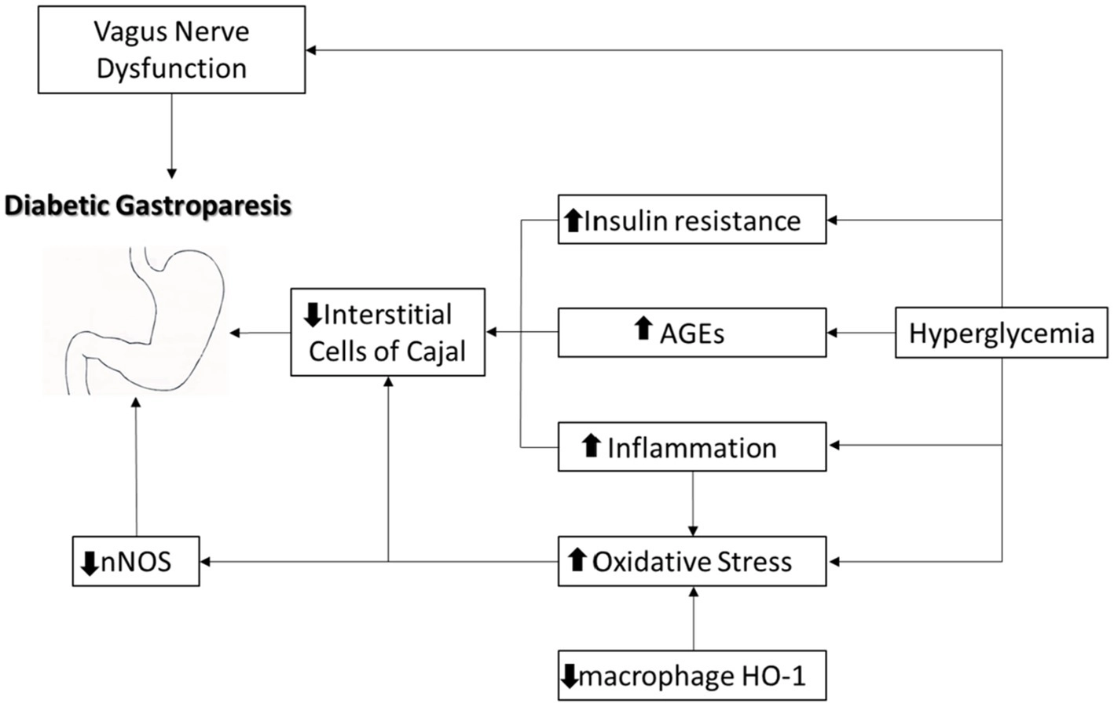
Notes:
**Main pathophysiological mechanisms associated with diabetic gastroparesis development. AGE—advanced glycation end-product
nNOS: Neuronal Nitric Oxidase: an enzyme that synthesizes nitric oxide (NO) regulates neurotransmission, synaptic plasticity, learning, and memory. It also regulates blood pressure, muscle contractility, and cardiovascular homeostasis

Slide 41
Clinical Presentation
Nausea and vomiting (often postprandial)
Early satiety
Postprandial fullness/bloating
Abdominal pain (epigastric)
Weight loss
Gastroparesis is 2–4× more common in females than males.

Slide 42
Diagnosis
Gold standard is 4-hour gastric emptying scintigraphy using a standardized low-fat egg-white meal (Eggbeaters) labeled with Tc-99m (radioactic tracer).
Key diagnostic thresholds:
Delayed emptying: Greater than 10% retention at 4 hours.
Severe retention: Greater than 60% retention at 2 hours.
Critical pre-test requirements:
Exclude mechanical obstruction first (via EGD or upper GI series)
Stop interfering medications 48–72 hours before testing: opioids, anticholinergics, prokinetics, antiemetics, cannabinoids
In diabetics, blood glucose should be <180–250 mg/dL on the day of testing; hyperglycemia itself delays emptying
Alternative tests include 13C breath testing (no radiation, validated alternative) and the wireless motility capsule (SmartPill)

Slide 43
Treatment
Step 1: General measures (all patients)
Discontinue medications that delay gastric emptying (opioids, GLP-1 agonists, anticholinergics)
Optimize glycemic control in diabetics
Dietary modification: small-particles, low-fat, low-fiber diet; frequent small meals; increase liquid-calorie intake

Slide 44
Treatment
Step 2: Pharmacotherapy
Metoclopramide — the only FDA-approved drug for gastroparesis.
Dopamine D2 antagonist and 5-HT4 agonist that accelerates gastric emptying.
Carries an FDA Black Box Warning for tardive dyskinesia — risk increases with duration and cumulative dose; avoid use >12 weeks when possible.
Common side effects: restlessness, drowsiness, fatigue, extrapyramidal symptoms, hyperprolactinemia.
Erythromycin — motilin receptor agonist; effective short-term prokinetic (250 mg TID before meals), but limited by tachyphylaxis and risk of QT prolongation (use in caution with cardiac patients)
Antiemetics (symptom relief, do not improve emptying): ondansetron (5-HT3 antagonist), prochlorperazine (D2 antagonist), promethazine (H1 antagonist),
Emetrol (Dextrose, fructose, and phosphoric acid combination)- use caution with diabetic patients
Notes:
**Motilin agonist: stimulate gut muscle contractions, accelerate stomach emptying

Slide 45
Treatment
Step 3: Refractory disease
Gastric per-oral endoscopic myotomy (G-POEM) —for refractory symptoms, especially nausea/vomiting; has largely replaced surgical pyloroplasty and botulinum toxin injection
Nutritional support: jejunostomy tube feeding for patients unable to maintain adequate oral intake
parenteral nutrition is a last resort

Slide 46

***Pearls
Gastroparesis ≠ mechanical obstruction — always rule out obstruction first with EGD
Most common etiology is idiopathic, not diabetic
Metoclopramide is the only FDA-approved drug; know the Black Box Warning for tardive dyskinesia and the 12-week limit
Erythromycin works as a prokinetic (motilin agonist), not as an antibiotic in this context
GLP-1 receptor agonists (semaglutide, liraglutide) are an increasingly recognized cause of delayed gastric emptying — must be held before testing

Slide 47
Peptic Ulcer Disease
(PUD)

Slide 48
PUD
Definition and Epidemiology
Refers to ulcerations in the stomach or duodenum that extend through the mucosa into the submucosa or deeper.
In the US, PUD affects approximately 1% of the population, with ~54,000 annual hospitalizations for bleeding ulcers and ~10,000 deaths per year.

Slide 49
PUD
Etiology — The "Big Three"
H. pylori infection (~42% of PUD cases)
NSAIDs/aspirin (~36%)
Idiopathic (~22%) — no identifiable cause
Other contributors include smoking, alcohol, steroids, critical illness (stress ulcers), and rarely Zollinger-Ellison syndrome (rare-gastrin releasing tumors

Slide 50
PUD
Pathophysiology
PUD results from an imbalance between mucosal protective factors (mucus, bicarbonate, prostaglandins, mucosal blood flow, tight junctions) and aggressive factors (acid, pepsin, H. pylori, NSAIDs).

Slide 51
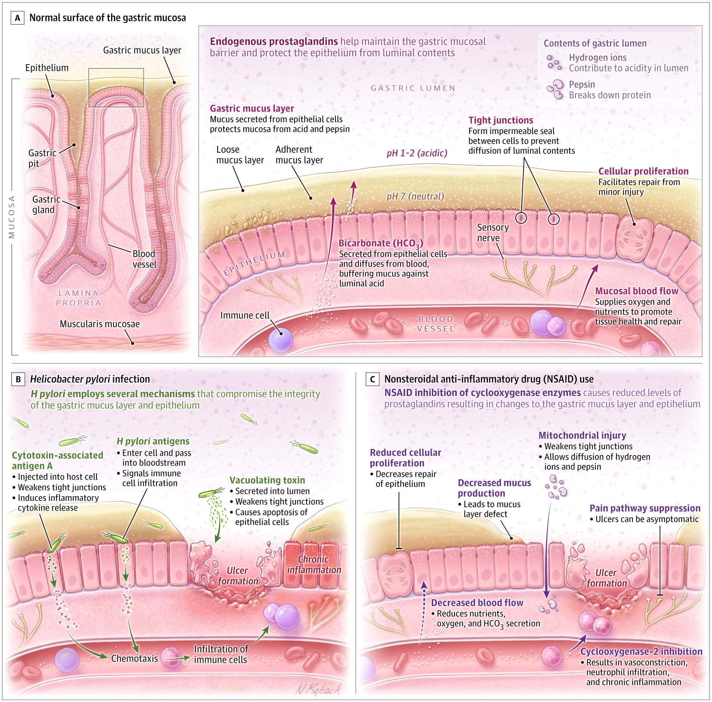
The Gastric Mucosal Barrier and the Pathogenesis of Peptic Ulcer Disease
Notes:
Peptic Ulcer Disease: A Review. JAMA. December 2, 2024.
Content used under license from the JAMA Network® © American Medical Association

Slide 52
Key mechanisms
H. pylori: A flagellated, urease-producing bacterium that colonizes the gastric mucosa.
-It disrupts tight junctions, triggers chronic inflammation, and alters acid regulation.
NSAIDs: Inhibit COX-1, reducing prostaglandin synthesis → decreased mucus/bicarbonate secretion, impaired mucosal blood flow, and reduced epithelial regeneration.
also suppress pain pathways, making NSAID-induced ulcers more likely to be asymptomatic and present with complications

Slide 53
Clinical Presentation
Dyspepsia (epigastric pain/discomfort)
present in ~81% of patients
symptoms are nonspecific
Classic symptom patterns:
Duodenal ulcer: Burning epigastric pain that improves with eating, then worsens 2–3 hours later
nocturnal pain (circadian acid secretion)
Gastric ulcer: Postprandial pain, nausea, vomiting, weight loss
Important caveats: elderly patients are frequently asymptomatic.
Bleeding can occur without warning symptoms in nearly half of patients.

Slide 54
Complications
Bleeding (73% of complications) — hematemesis, melena, or hematochezia if brisk; case fatality 5–10%
Perforation (9%) — sudden severe abdominal pain, acute abdomen, free air on imaging; mortality up to 20%
Gastric outlet obstruction (3%) — nausea, vomiting, early satiety, weight loss

Slide 55
Diagnosis
Endoscopy (EGD) is the gold standard — sensitivity 92%
Direct visualization, biopsy for H. pylori and malignancy, and therapeutic intervention for bleeding.
Test-and-treat strategy for patients <60 years with dyspepsia and no alarm features:
Test for H. pylori (urea breath test or stool antigen — noninvasive)
If positive → eradicate
If negative → empiric PPI trial for 4 weeks
If symptoms persist → EGD

Slide 56
Alarm features requiring EGD
Age ≥60 with new-onset dyspepsia
Unintended weight loss
GI bleeding
Progressive dysphagia/odynophagia
Persistent vomiting
Palpable mass or lymphadenopathy

Slide 57
Diagnosis
Gastric ulcers should always be biopsied at the ulcer edge to rule out malignancy.
H. pylori testing: Hold PPIs for ≥2 weeks and antibiotics/bismuth for ≥4 weeks before testing to avoid false negatives.

Slide 58
Treatment
Acid suppression: PPIs (omeprazole, pantoprazole, etc.) are the mainstay. They heal 80–100% of ulcers within 4 weeks; gastric ulcers >2 cm may need 8 weeks.
Vonoprazan, a potassium-competitive acid blocker (P-CAB), is a newer alternative with >90% healing rates.
H. pylori eradication is critical — it reduces ulcer recurrence from 50–60% to 0–2%.
Regimens (14-day courses preferred)

Slide 59
Treatments
Regimen | Components | Notes
Bismuth quadruple therapy | PPI + bismuth + tetracycline + metronidazole | Preferred first-line in many regions; effective regardless of clarithromycin resistance
Concomitant quadruple therapy | PPI + clarithromycin + amoxicillin + metronidazole | Alternative first-line; avoid if local clarithromycin resistance >15%
Triple therapy | PPI + clarithromycin + amoxicillin (or metronidazole) | Declining efficacy (<70% in many areas); use only if local clarithromycin resistance is low
Vonoprazan-based regimens | Vonoprazan + amoxicillin ± clarithromycin | High eradication rates even with clarithromycin-resistant strains

Slide 60
Risk Factors and Treatments for N-SAID related ulcers
Risk Factors: age >65, prior PUD, concomitant antiplatelet/anticoagulant/corticosteroid/SSRI use, high-dose NSAIDs
Treatments: Discontinue the NSAIDs
If NSAIDs cannot be stopped, strategies include adding a PPI, switching to a COX-2 inhibitor, or ideally combining a COX-2 inhibitor (i.e. celecoxib) + PPI for highest-risk patients.
Patient requiring preventative management for cerebrovascular and cardiovascular events, Rheumatoid arthritis

Slide 61
Management of Upper GI Bleeding from PUD
Key principles:
Resuscitate first — crystalloids, transfuse if Hgb <7-8 g/dL (depending on the case)
Glasgow-Blatchford Score (GBS) ≤1 → safe for outpatient management
EGD within 24 hours for all admitted patients

Slide 62
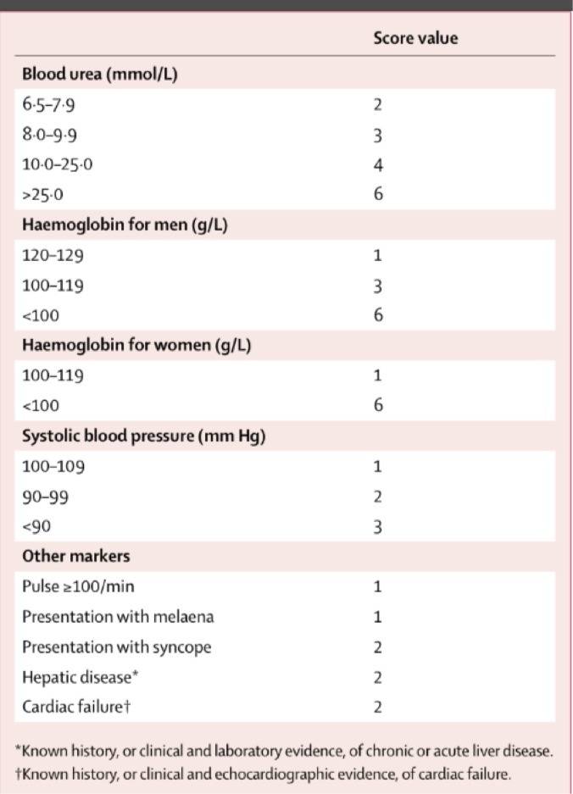
GBS Score Chart

Slide 63
***Pearls***
Duodenal ulcers are more common than gastric ulcers and more strongly associated with H. pylori
Gastric ulcers must be biopsied to rule out malignancy; duodenal ulcers rarely need biopsy (duodenal cancer is exceedingly rare)
Posterior duodenal ulcers can erode into the gastroduodenal artery → massive hemorrhage
Posterior gastric ulcers can erode into the splenic artery
Anterior duodenal ulcers are more likely to perforate (free perforation into peritoneum)
Confirm H. pylori eradication with a urea breath test or stool antigen ≥4 weeks after completing therapy
Zollinger-Ellison syndrome: suspect when ulcers are multiple, distal (jejunal), or refractory to standard PPI therapy; check fasting serum gastrin

Slide 64
Pyloric Stenosis
Medical Terminology:
Pylor/o: referring to the lower opening of the stomach
-stenosis (Suffix/Root) Meaning: abnormal narrowing or tightening

Slide 65
Pyloric Stenosis
Infantile hypertrophic pyloric stenosis (IHPS)
Epidemiology & Risk Factors
Incidence: approximately 1–5 per 1,000 live births
Male-to-female ratio ~4–5:1
More common in firstborn children, Caucasian infants, and those with a positive family history
Caused by a combination of many genes and environmental factors

Slide 66
Pathophysiology
The pyloric muscle thickens(hypertrophy)
gradually narrowing the stomach outlet and creating a blockage that stops food from passing into the intestine.
Develops after birth—typically between 3 to 6 weeks of age—rather than being present from birth.

Slide 67
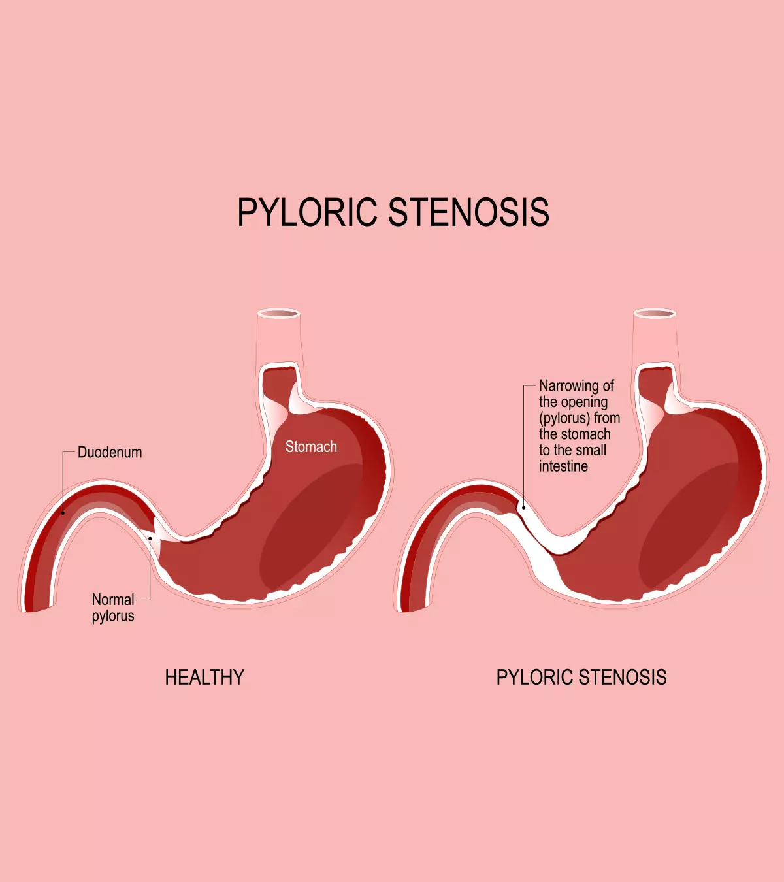

Slide 68
Classic Presentation
Nonbilious, projectile vomiting — the hallmark symptom.
Vomiting is nonbilious because the obstruction is proximal to the ampulla of Vater.
The infant is classically described as
"hungry vomiter" — eager to feed immediately after vomiting
Progressive dehydration, weight loss, and failure to thrive if untreated
Physical exam: palpable "olive-shaped" mass in the right upper quadrant/epigastrium (though sensitivity of palpation is only ~74%)
Visible gastric peristaltic waves may be observed across the upper abdomen

Slide 69
Metabolic Derangement — A Board Favorite
Persistent vomiting of gastric acid (HCl) leads to a characteristic hypochloremic, hypokalemic metabolic alkalosis. The cascade:
Loss of H⁺ and Cl⁻ → metabolic alkalosis and hypochloremia
Kidneys attempt to conserve Cl⁻ by exchanging K⁺ for H⁺ in the distal tubule → hypokalemia and paradoxical aciduria
Severe alkalosis can cause compensatory hypoventilation and even central apneas in infants.

Slide 70
Diagnosis
Abdominal ultrasound is the gold standard — sensitivity and specificity approaching 100%
Key US measurements: pyloric muscle thickness ≥3 mm (single wall) and pyloric canal length ≥14–16 mm
Classic sonogram findings include the "target sign" (transverse view) and elongated pyloric canal (longitudinal view)
Upper GI barium study
shows the "string sign" (narrow pyloric channel)
"shoulder sign" (mass impression on the antrum)

Slide 71
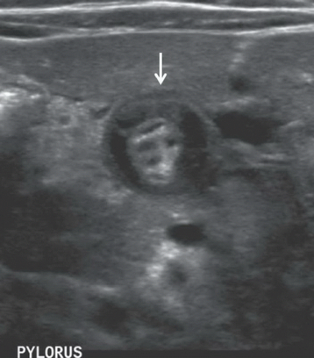
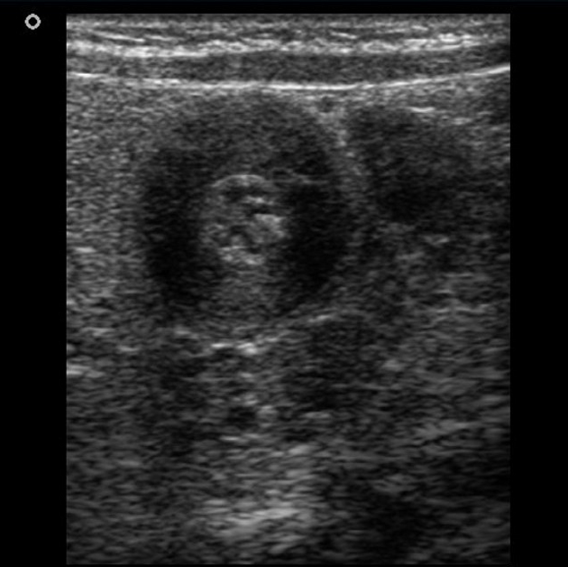
Target Sign

Slide 72
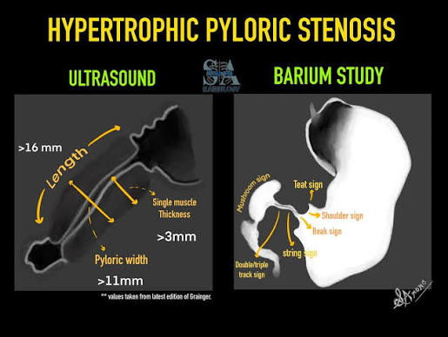

Slide 73
Management
Preoperative stabilization is critical —medical emergency
Correct dehydration and electrolyte abnormalities (especially chloride and potassium) with IV normal saline with KCl before proceeding to surgery.
Metabolic derangements should be corrected to reduce anesthetic risk (particularly apnea from alkalosis) prior to surgery

Slide 74
Definitive treatment: Ramstedt pyloromyotomy
a longitudinal incision through the serosa and hypertrophied muscle down to (but not through) the mucosa.
This can be performed via:
Open approach (right upper quadrant or circumumbilical incision)
Laparoscopic approach — increasingly preferred
associated with fewer complications
shorter hospital stay, and less postoperative pain
Prognosis is excellent with near-zero mortality after surgical correction

Slide 75
***Pearls***
Nonbilious vomiting → obstruction proximal to the ampulla of Vater (pyloric stenosis)
Bilious vomiting → obstruction distal to the ampulla (think malrotation with midgut volvulus — a surgical emergency)
Pyloric stenosis is not present at birth; symptoms develop at 3–6 weeks
The metabolic picture (hypochloremic, hypokalemic metabolic alkalosis)

Slide 76
Mystery Case (Continued)
“Shocking New Revelation”

Slide 77
Mystery Case
Now, Ms. Riding Hood, just revealed that in addition to having burning epigastric abd pain, nausea, vomiting, bloating, early satiety she also and black tarry stools 6 days ago.
What is her diagnosis?

Slide 78
Gastrointestinal Bleeding
(GIB)

Slide 79
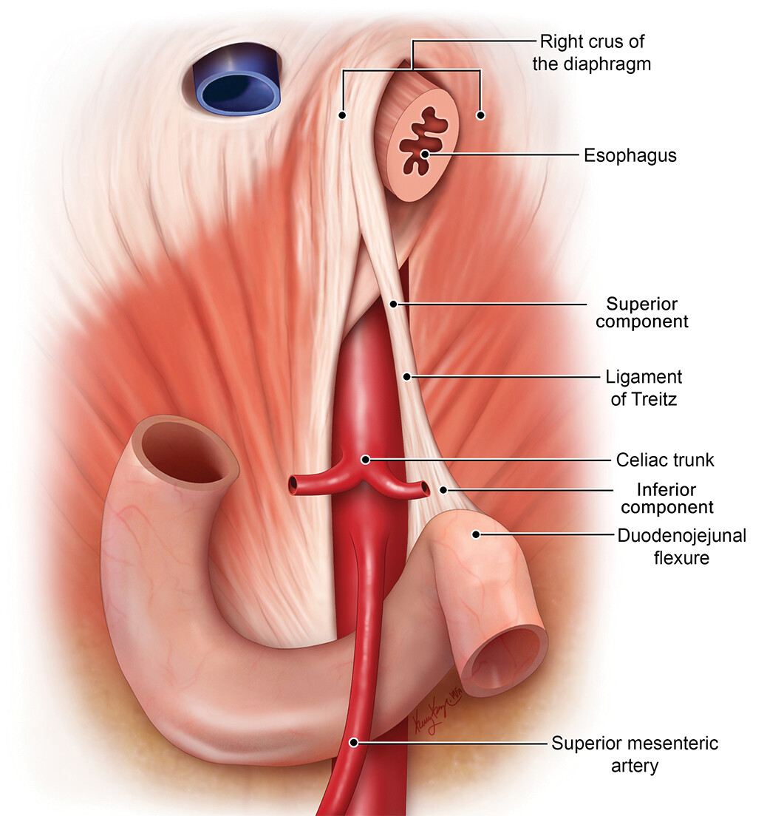
Gastrointestinal Bleeding
Definition, Classification, Pathophysiology
GI bleeding is classified by anatomic location relative to the ligament of Treitz:
upper GI bleeding (UGIB) originates proximal (esophagus, stomach, duodenum),
lower GI bleeding (LGIB) originates distal to it.
GIB can also be categorized as
overt (visible hematemesis, melena, hematochezia),
occult (guaiac-positive stools or iron deficiency anemia without visible blood)
obscure (unknown source despite complete evaluation).

Slide 80
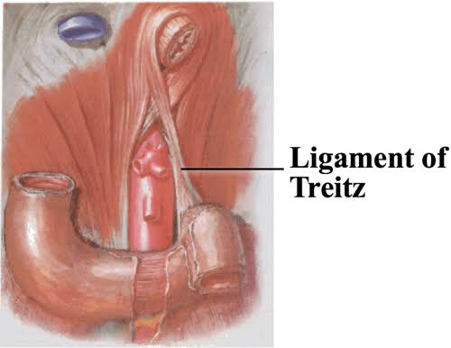
Clinical Presentations
Hematemesis (bloody or coffee-ground emesis) → strongly suggests UGIB
Melena (black, tarry stools) → typically UGIB, but can originate from small bowel or right colon
Hematochezia (bright red blood per rectum) → usually LGIB, but can occur with brisk UGIB

Slide 81
Common Etiologies
UGIB Causes | LGIB Causes
Peptic ulcer disease (most common; H. pylori, NSAIDs) | Diverticulosis (most common, 30–65%)
Erosive esophagitis/gastritis | Ischemic colitis (5–20%)
Esophageal/gastric varices (portal HTN) | Hemorrhoids (5–20%)
Mallory-Weiss tear (post-retching) | Colorectal polyps/neoplasms (2–15%)
Vascular ectasias, Dieulafoy lesion | Angioectasias (5–10%)
Neoplasms | IBD, infectious colitis
Aortoenteric fistula (rare but lethal) | Post-polypectomy bleeding

Slide 82
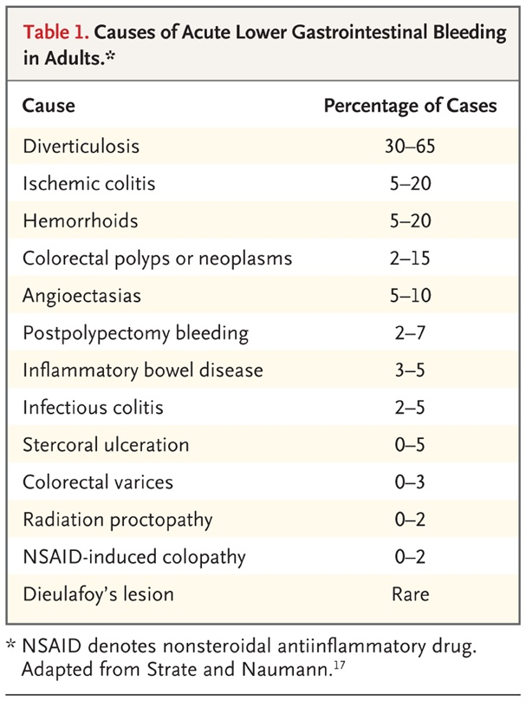
Causes of Acute Lower Gastrointestinal Bleeding in Adults
Notes:
Acute Lower Gastrointestinal Bleeding. N Engl J Med. March 15, 2017.
Used under license from The New England Journal of Medicine.

Slide 83
Initial Assessment and Resuscitation
A focused history, physical exam, and labs should be obtained simultaneously with hemodynamic resuscitation.
Key steps:
ABCs and hemodynamic status:
Assess for tachycardia, hypotension, orthostasis, and signs of shock.
Initiate IV crystalloid resuscitation for hemodynamically unstable patients.
Labs: CBC, BMP (BUN/Cr), coagulation panel, liver function tests, type and crossmatch.
Transfusion threshold: A restrictive transfusion strategy (transfuse when Hgb <7 g/dL)
Hypotensive patients may be transfused before reaching these thresholds.

Slide 84
Risk Stratification Scores
Glasgow-Blatchford Score (GBS) (range 0–23): Best validated for predicting need for intervention (transfusion, endoscopy, surgery) or death.
A GBS ≤1 identifies very low-risk patients who may be safely managed as outpatients. A GBS ≥7 predicts likely need for endoscopic therapy.
Rockall Score: Requires endoscopic findings for the full score;
predicts rebleeding and mortality in hospitalized patients.
The GBS is the most recommended first-line triage tool per current guidelines

Slide 85
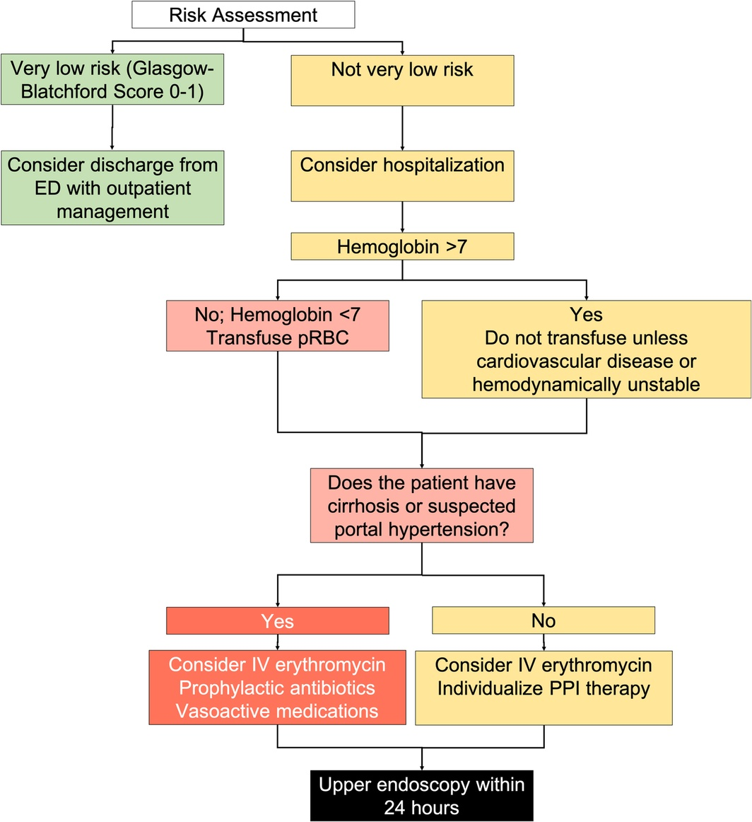
Management of UGIB
Notes:
Figure 1. Pre‐endoscopic management for patients with acute upper gastrointestinal bleeding.
Review article: Upper gastrointestinal bleeding – review of current evidence and implications for management. Aliment Pharmacol Ther. April 30, 2024

Slide 86
Key management principles
PPI therapy: Initiate upon presentation.
After endoscopic hemostasis for high-risk ulcer patients, high-dose PPI (80 mg IV bolus → 8 mg/hr infusion, or intermittent dosing totaling 80–160 mg/day) for 72 hours markedly (reduces rebleeding, surgery, and mortality.)
Endoscopy within 24 hours for all admitted patients with UGIB.
Resuscitation should precede endoscopy.
Endoscopic hemostasis: Epinephrine injection should never be used alone — always combine with a second modality (thermal, clips).
Variceal bleeding: Requires antibiotics (e.g., ceftriaxone) + vasoactive drugs (octreotide or terlipressin) started at presentation.
Erythromycin (250 mg IV) given 30–120 minutes pre-endoscopy can improve gastric visualization and reduce need for repeat endoscopy.
Failed endoscopic hemostasis: Attempt repeat endoscopy → if unsuccessful, proceed to transcatheter arterial embolization (TAE) → surgery as last resort.
Notes:
**Endoscopic hemostasis: Stopping blood leaks inside the body with a small camera tool sent down the throat or rectum
Erythromycin is given during upper gastrointestinal (GI) bleeding not for its antibiotic properties, but as a prokinetic agent (to stimulate gut movement) that clears blood and clots from the stomach before an endoscopy-MOTILIN AGONIST

Slide 87
Management of LGIB
~75% of LGIB episodes stop spontaneously.
Colonoscopy (after bowel prep) is the preferred diagnostic and therapeutic modality for hemodynamically stable patients, ideally within 8–24 hours of admission.
For hemodynamically unstable patients or those with suspected ongoing bleeding, CT angiography is the initial study of choice to localize the bleeding source, followed by embolization if positive.
The Oakland Score can help risk-stratify LGIB patients for safe outpatient management
Notes:
An Oakland Score of ≤ 8 (out of a possible 35) identifies patients with acute lower gastrointestinal bleeding who are at low risk for adverse events and are generally safe for outpatient management and discharge

Slide 88
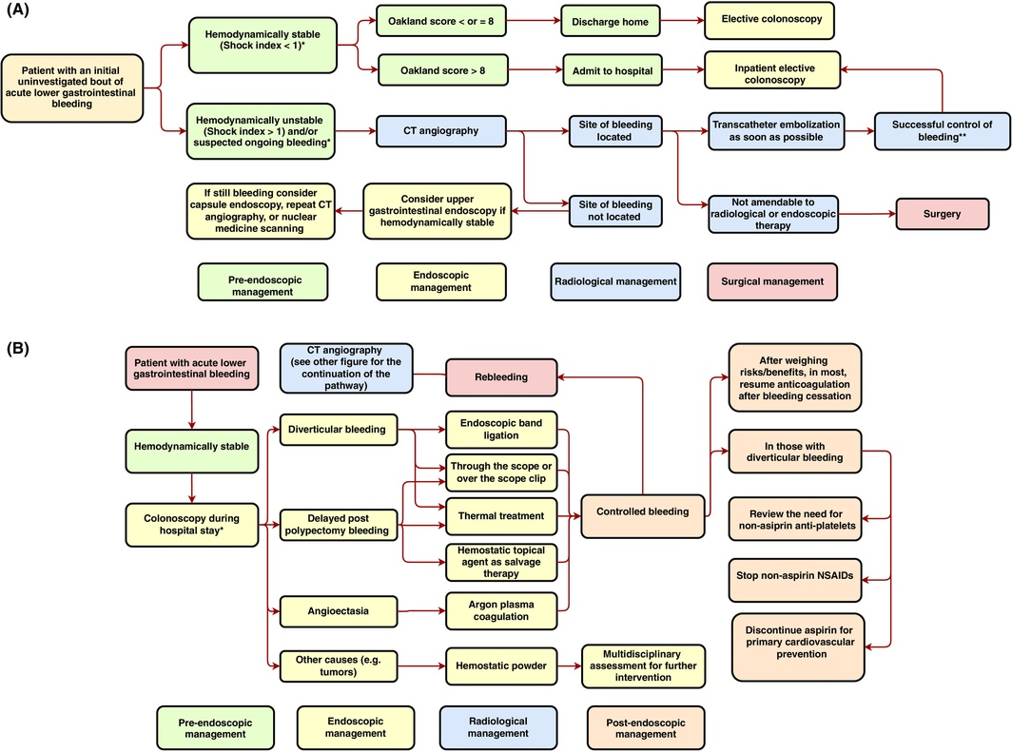
Initial evaluation of patients presenting with acute lower gastrointestinal bleeding (Using the Oakland score)
Notes:
Review article: Advances in the management of lower gastrointestinal bleeding. Aliment Pharmacol Ther. February 29, 2024.
Used under license from Wiley.

Slide 89
****Pearls
Always consider UGIB in patients with hematochezia and hemodynamic instability — brisk upper sources can present with bright red blood per rectum.
NSAIDs and H. pylori are the two most important modifiable risk factors for peptic ulcer bleeding.
A GBS of 0–1 is the threshold for safe outpatient management of UGIB.
*Aortoenteric fistula is rare but must be considered in any patient with a history of aortic graft and GI bleeding — it is a surgical emergency.
In cirrhotic patients with GI bleeding, always assume variceal source until proven otherwise and start antibiotics + vasopressors empirically.
Notes:
Glasgow-Blatchford Score (GBS) (range 0–23): Best validated for predicting need for intervention (transfusion, endoscopy, surgery) or death. A GBS ≤1 identifies very low-risk patients who may be safely managed as outpatients. A GBS ≥7 predicts likely need for endoscopic therapy.

Slide 90
Mystery Case (Continued)
“More Revelations”

Slide 91
Mystery Case
Now, Ms. Riding Hood, in addition to having burning epigastric abd pain, nausea, vomiting, bloating, early satiety, black tarry stools 6 days ago. Now her pain has radiated to her RLQ and her temp is now 102.3 F and she is still very nauseous and is vomiting.
What is her diagnosis?

Slide 92
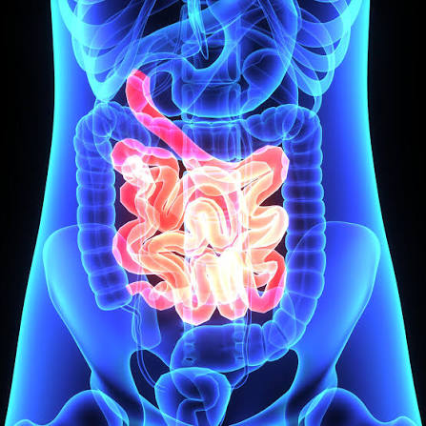
Diseases of the Small Intestine
Appendicitis
Celiac disease
Intussusception
Obstruction
Polyps

Slide 93
Appendicitis
Medical Terminology
Appendic-: Refers to the appendix, coming from the Latin word meaning "something attached".
-itis: A medical suffix that means "inflammation of".

Slide 94
Appendicitis
Epidemiology
Acute appendicitis is the most common abdominal surgical emergency worldwide,
Incidence peaks in the second decade of life with a male-to-female ratio of approximately 2:1.
It is also the most common non-obstetric surgical emergency during pregnancy.

Slide 95
Pathophysiology
The key mechanism is appendiceal luminal obstruction → increased intraluminal pressure → vascular compromise → ischemia → necrosis → perforation.
Causes of obstruction vary by age:
Young adults: lymphoid follicular hyperplasia (55–65% of cases)
Older adults: appendicoliths or neoplasm
Other causes: fecaliths (~35%), foreign bodies, parasitic infections, tumors
As the appendix distends, T8–T10 visceral afferent nerves produce vague periumbilical pain.
When inflammation reaches the parietal peritoneum, somatic nerve stimulation causes the classic migration to the right lower quadrant.

Slide 96
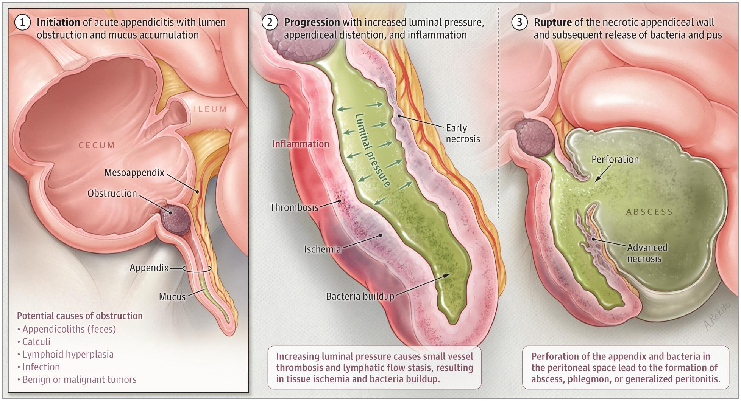
Pathophysiology of Acute Appendicitis

Slide 97
Clinical Presentation
Vague periumbilical pain (visceral)
Anorexia, nausea, vomiting (pain typically precedes vomiting)
Migration of pain to the RLQ within ~24 hours
Low-grade fever
Important caveat: only about 40% of patients present with all classic features.
Atypical presentations are common with retrocecal or pelvic appendix( back or lower pelvic) positions.

Slide 98
Key Physical Exam Signs
Sign | Description | Sensitivity | Specificity
McBurney point | Tenderness 1/3 distance from ASIS to umbilicus | 50–94% | 75–86%
Rovsing sign | RLQ pain with LLQ palpation | 22–68% | 58–96%
Psoas sign | RLQ pain with passive R hip extension (retrocecal appendix) | 13–42% | 79–97%
Obturator sign | RLQ pain with R hip flexion + internal rotation (pelvic appendix) | 5–15% | 90–95%
Rebound tenderness | Pain on release of pressure (peritonitis) | 55–70% | 65–80%
Notes:
ASIS stands for the Anterior Superior Iliac Spine.

Slide 99
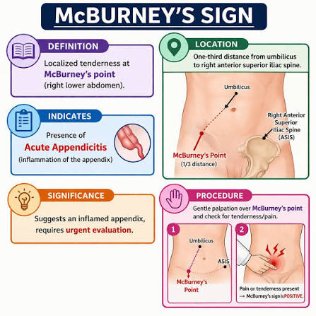
McBurney’s Sign

Slide 100
Laboratory Evaluation
CBC with differential: Mild leukocytosis (WBC >10,000/μL) in 67–90% of patients; ~80% have a left shift (increase in immature white blood cells, specifically band neutrophils)
WBC sensitivity ~70–80%, specificity ~55–65% — a normal WBC does not rule out appendicitis
Higher WBC correlates with gangrenous or perforated appendicitis.
Urinalysis: to rule out UTI (mild pyuria/hematuria can occur from adjacent inflammation)
β-hCG: mandatory in women of reproductive age to exclude ectopic pregnancy

Slide 101
Scoring Systems
The Alvarado score (MANTRELS mnemonic) is the most widely studied tool. A score <4 makes appendicitis unlikely; 4–6 warrants imaging; ≥7 suggests surgical consultation.
However, ACEP (American College of Emergency Physicians (ACEP)) notes its diagnostic accuracy is insufficient to use alone without imaging.
The Appendicitis Inflammatory Response (AIR) score incorporates CRP and may outperform the Alvarado score in accuracy
Notes:
The Alvarado score is a clinical tool used to help doctors check if a person has acute appendicitis. It adds up points based on signs, symptoms, and blood test results to see how likely it is that the appendix is infected.
The Appendicitis Inflammatory Response (AIR) score uses clinical symptoms and laboratory markers to stratify the likelihood of acute appendicitis. Ranging from 0 to 12, it is heavily favored over the older Alvarado score for its inclusion of C-Reactive Protein (CRP) to accurately gauge disease severity

Slide 102
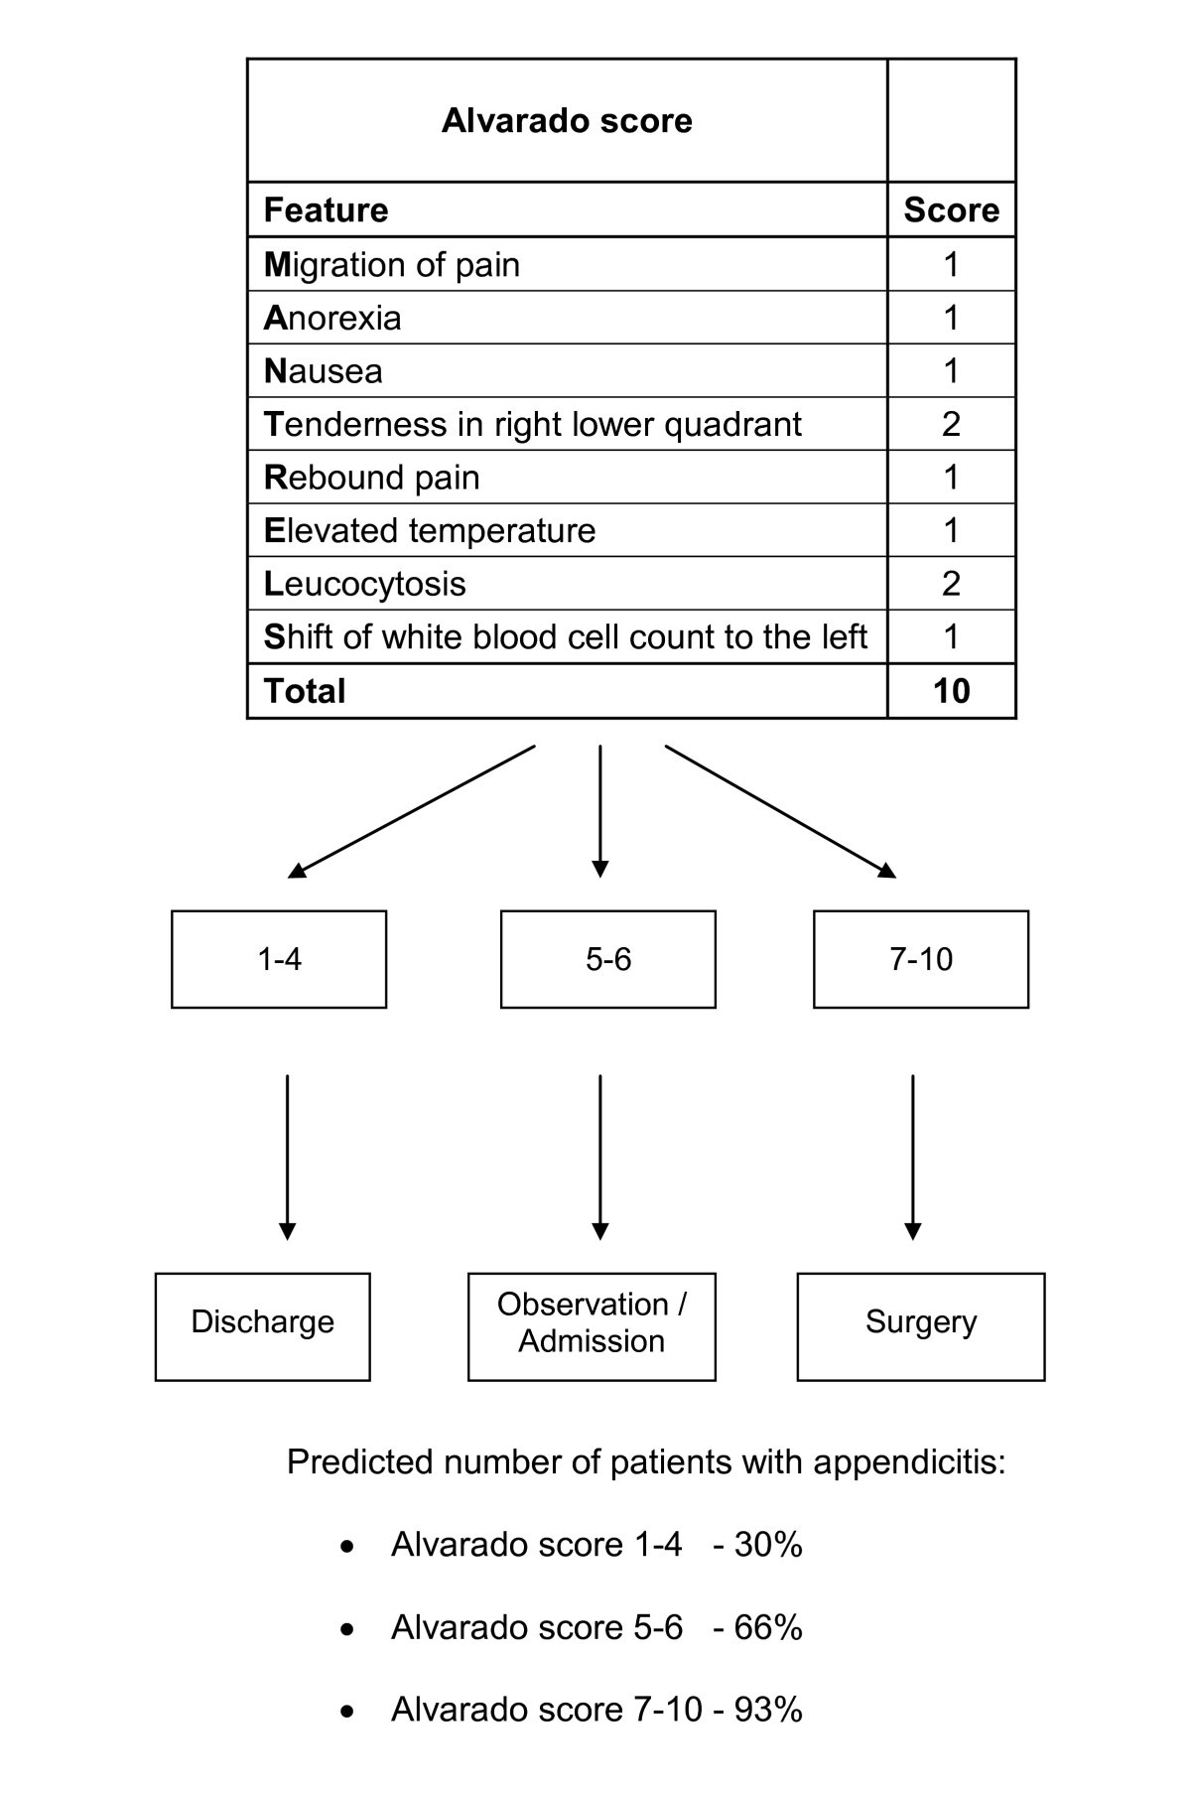
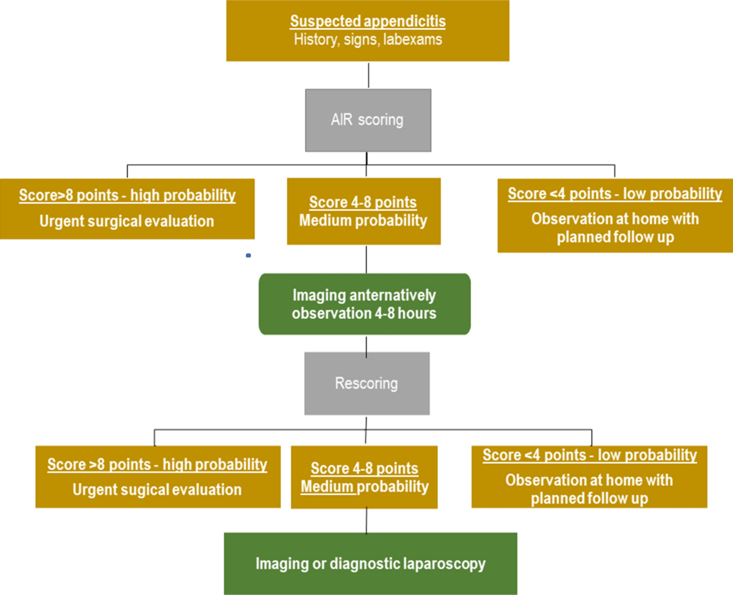
Scoring Systems
Alvardo Score
AIR Score

Slide 103
Diagnostic Imaging
CT abdomen/pelvis with IV contrast is the first-line imaging modality in adults in the US (sensitivity 96%, specificity 96%). Key CT findings:
Dilated appendix ≥7 mm
Appendiceal wall thickening/hyperenhancement
Periappendiceal fat stranding
Appendicoliths (present in ~40% of appendicitis cases; associated with 38.7% vs 4.4% perforation rate)
Complicated: wall defect, extraluminal gas, abscess, free fluid
Ultrasound is first-line in children and pregnant patients (no radiation).
MRI is used when CT is contraindicated (pregnancy, radiation concerns); sensitivity 95%, specificity 92%

Slide 104
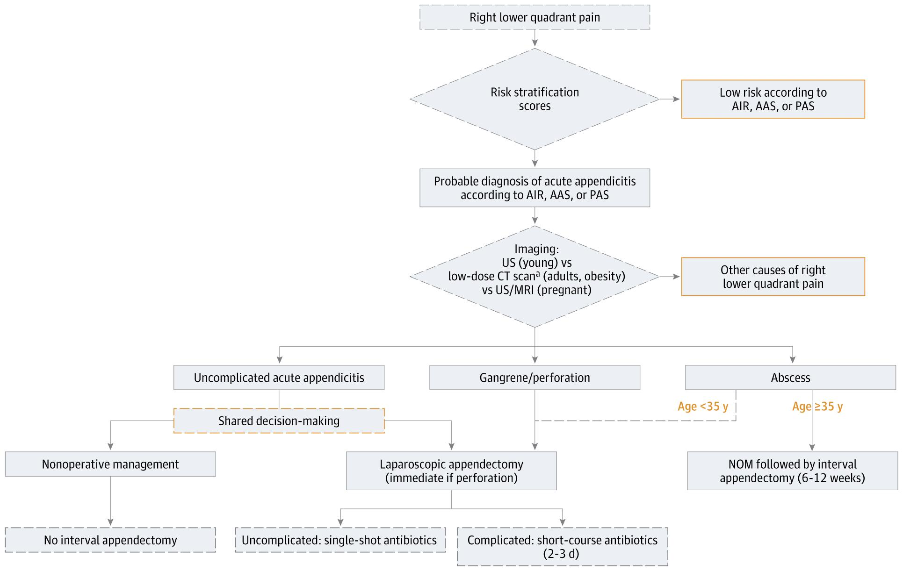
Diagnosis and Treatment of Acute Appendicitis: The 2025 Edition of the World Society of Emergency Surgery (WSES) Jerusalem Guidelines
Notes:
The 2025 Edition of the World Society of Emergency Surgery (WSES) Jerusalem Guidelines

Slide 105
Classification and Complications
Uncomplicated (~75–80%): inflamed appendix without perforation
Complicated (~20–25%): gangrenous, perforated, with abscess or phlegmon
Perforation risk increases with symptom duration:
Risk factors for perforation include male sex, older age, appendicoliths, and symptom duration >24 hours.

Slide 106
Management
Surgical (standard of care)
Laparoscopic appendectomy is the gold standard — associated with less postoperative pain, faster recovery, and earlier discharge compared with open surgery.
Emergent surgery is required for perforation with generalized peritonitis.
Antibiotics-first approach (for selected uncomplicated cases)
Approximately 70% of patients with uncomplicated appendicitis can be successfully treated with antibiotics alone.
Regimens: piperacillin-tazobactam monotherapy, or cephalosporin/fluoroquinolone + metronidazole for 7–10 days.
Over 5 years, 30–40% of antibiotic-treated patients will ultimately undergo appendectomy.
If an appendicolith (hardened piece of stool), a mass, or an appendix thicker than 13 mm is found on a CT scan, non-surgical treatment is much more likely to fail (about 40% of the time). Therefore, these patients should get surgery.

Slide 107
Management continued
Complicated appendicitis with abscess/phlegmon
Initial management: IV antibiotics ± percutaneous drainage
Interval appendectomy( planned surgical removal) may be considered, particularly in patients ≥35 years (to rule out underlying neoplasm)

Slide 108
Special Populations
Pregnant patients: Appendicitis most common in 2nd trimester. Perforation rates as high as 55% (vs 4–19% in general population) due to delayed/atypical presentation.
Physical exam signs are unreliable as the gravid uterus displaces the appendix.
Imaging: US first → MRI if equivocal (avoid CT if possible).
Appendectomy is advised when diagnosis is reasonably certain.
Pediatric patients: US is first-line imaging; if equivocal, follow with MRI or CT. The Pediatric Appendicitis Score (PAS) can aid risk stratification.
Elderly patients: More likely to present atypically (generalized pain, lack of leukocytosis) and have higher rates of complicated appendicitis.
Luminal obstruction by appendicolith or mass is more common
always consider underlying malignancy.

Slide 109
***Pearls***
Pain before vomiting (>90% sensitive) — distinguishes from gastroenteritis where vomiting often precedes pain
Migrating periumbilical → RLQ pain is the strongest clinical predictor
McBurney point is the single most important physical exam sign
Appendicoliths on CT = higher perforation risk and higher antibiotic failure rate.
In pregnancy: US → MRI (not CT); perforation risk is much higher
Nonoperative management is an option for uncomplicated appendicitis without appendicoliths, but ~1 in 3 patients will eventually need surgery.

Slide 110

Celiac Disease

Slide 111

Epidemiology and Genetics
Celiac disease affects approximately 1% of the population and is
an immune-mediated enteropathy triggered by gluten (wheat, barley, rye) in genetically susceptible individuals.
Nearly all patients carry HLA-DQ2 (>90%) or HLA-DQ8 (5–10%)
absence of both alleles essentially rules out celiac disease (high negative predictive value).
However, ~35% of the general population carries these alleles, so their presence alone is insufficient for diagnosis.

Slide 112
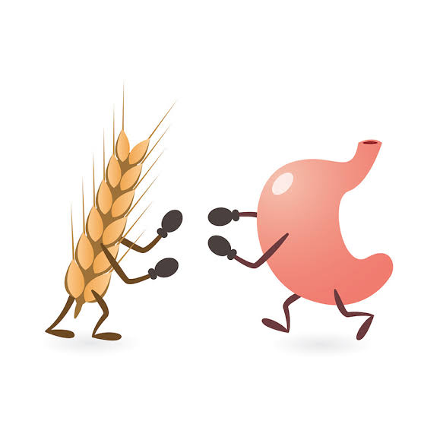

Pathophysiology
Undigested gluten peptides cross the gut lining.
Once inside, an enzyme called tTG modifies these peptides, making them bind strongly to immune system receptors (HLA-DQ2/DQ8).
This triggers both adaptive and innate immune responses, leading to chronic inflammation that damages the small intestine—specifically causing flattened villous linings, enlarged crypts, and a buildup of immune cells
*Simplified Version*
Parts of gluten survive digestion and slip through the intestinal wall.
There, they trigger an immune reaction that causes severe inflammation and damages the lining of the small intestine.

Slide 113
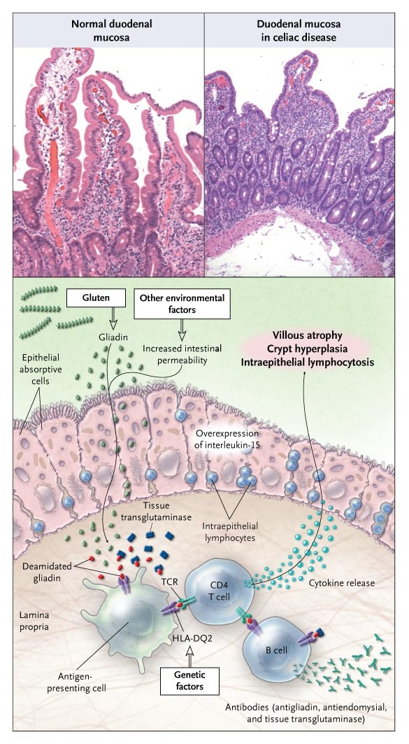
Interaction of Gluten with Environmental, Immune, and Genetic Factors in Celiac Disease

Slide 114
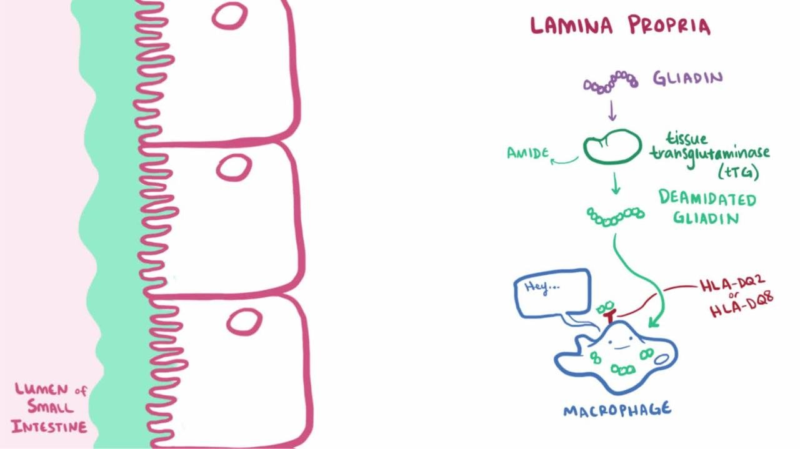
Step by Step Breakdown
Eat Gluten: Gluten contains a protein called gliadin.
Immune Trigger: In people with specific genes (HLA-DQ2 or HLA-DQ8), the immune system treats gliadin like an enemy.
Enzyme Action: An enzyme named tTG changes the gliadin piece to make the immune reaction even stronger.
Gut Damage: White blood cells attack the lining of the small intestine, causing inflammation.
Flattened Villi: The helpful finger-like folds (villi) wear down and flatten out (villous atrophy).
Bad Absorption: With fewer working villi, the body cannot absorb vitamins, minerals, and water properly, leading to stomach pain, weight loss, and fatigue.

Slide 115
Clinical Presentation and (“the why”)
Classic GI symptoms: Diarrhea (~40–50% of patients), bloating, abdominal pain, constipation, steatorrhea, weight loss, bloating
Iron-deficiency anemia refractory to oral supplementation (seen in ~32% of adults)
Osteoporosis/osteopenia (up to 60% of patients)
Dermatitis herpetiformis (“antibodies binding to proteins in the skin to form an intensely itchy rash.”)
- Intensely pruritic, papulovesicular rash on extensor surfaces (elbows, knees, buttocks); diagnosed by granular IgA deposits on perilesional skin biopsy — this is pathognomonic
Elevated liver transaminases (“a damaged gut allows intestinal inflammation, toxins, and immune proteins to travel directly to the liver through the blood”)
Neuropsychiatric (“the body's immune antibodies mistakenly attack nervous system tissue or cause brain inflammation” ): Peripheral neuropathy, cerebellar ataxia, migraine
Reproductive (“immune attacks to reproductive tissues”): Infertility, recurrent miscarriage, delayed menarche
Pediatric (“stops the SI from absorbing vital nutrients”): Growth failure, delayed puberty, dental enamel defects

Slide 116
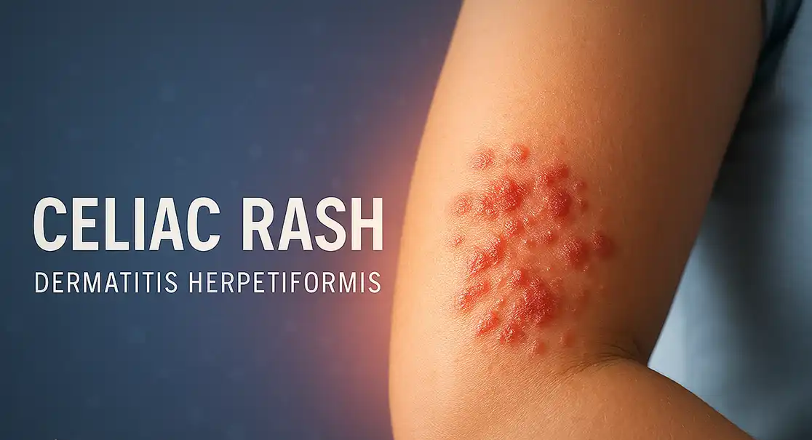
Dermatitis herpetiformis

Slide 117
Diagnosis
The diagnostic approach follows a serologic-then-biopsy algorithm per ACG guidelines:
First-line test: IgA anti-tissue transglutaminase (tTG-IgA) — sensitivity ~93%, specificity ~98%
Simultaneously check total serum IgA — selective IgA deficiency occurs in 2–3% of celiac patients and causes false-negative IgA-based tests
If IgA-deficient → use IgG-based testing
Confirmatory test in adults: Upper endoscopy with ≥4 duodenal biopsies (lesions can be patchy) showing villous atrophy, crypt hyperplasia, and >25 intraepithelial lymphocytes
Endomysial antibody (EMA-IgA): Near 100% specificity; used as a confirmatory test
Avoiding Biopsy in Children: According to ESPGHAN guidelines, a celiac disease diagnosis can be made without a biopsy if the tTG-IgA level is at least 10 times the upper limit of normal and a separate blood test is positive for EMA.
Critical point: Testing must be performed while the patient is on a gluten-containing diet — a gluten-free diet causes false negatives.

Slide 118
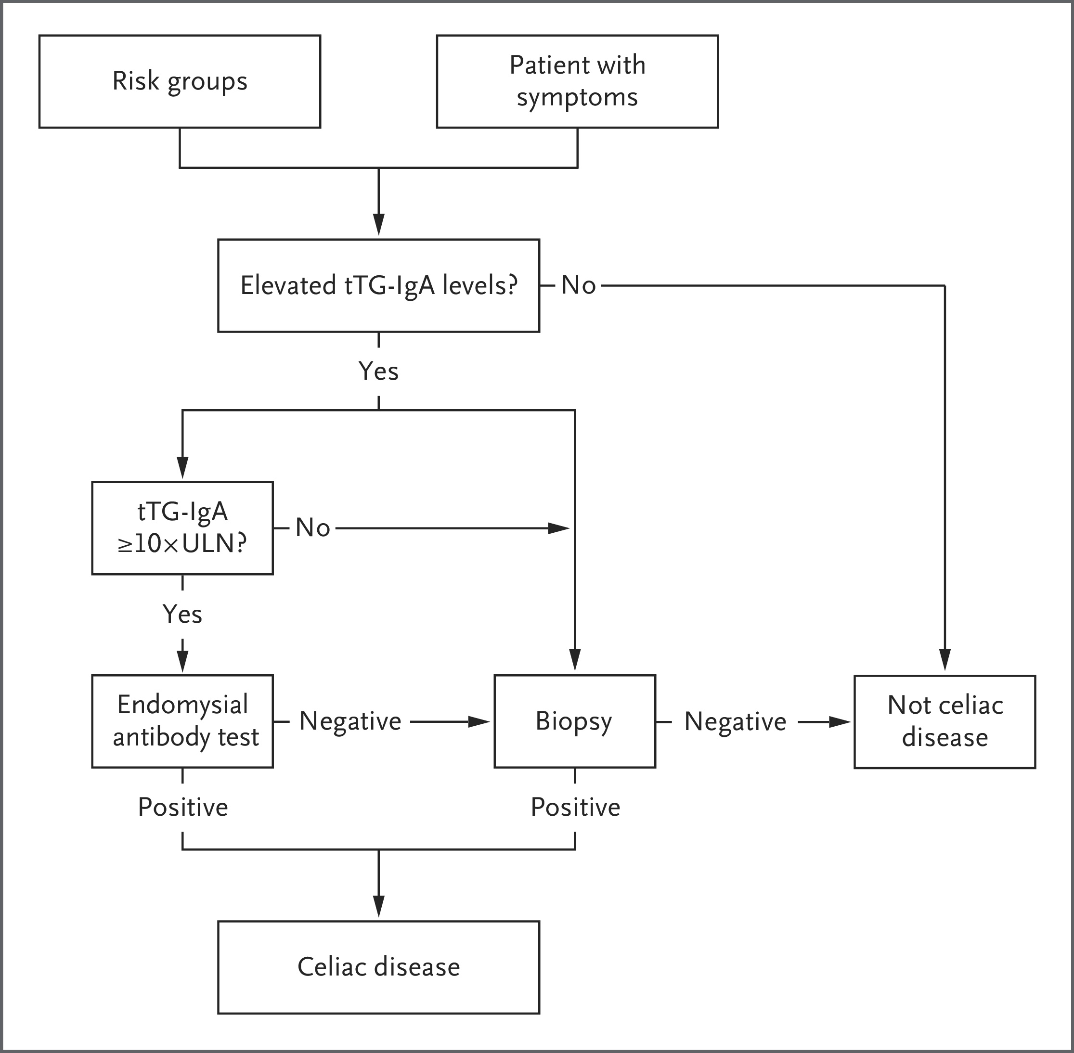
Diagnosis of Celiac Disease

Slide 119
Associated Conditions and Who to Screen
High-Risk Group | Prevalence of Celiac Disease
First-degree relatives | ~5–10%
Type 1 diabetes | 1.6–16.4%
Autoimmune thyroid disease (Hashimoto's, Graves') | Increased
Down syndrome, Turner syndrome, Williams syndrome | Increased
Selective IgA deficiency | Increased
Dermatitis herpetiformis | ~100% (DH is celiac disease of the skin)

Slide 120
Management
Strict lifelong gluten-free diet (GFD) is the only effective treatment — avoid wheat, barley, and rye
Dietitian referral is recommended at diagnosis.
Symptoms typically improve within days to weeks; diarrhea resolves in ~80% within 60 days. Mucosal healing takes months to years.
tTG-IgA should decline on GFD and is used to monitor adherence; full normalization may take >2 years.

Slide 121
Baseline and follow-up workup
CBC, iron/ferritin, folate, vitamins B12, D, A, E, zinc, copper
Liver enzymes (AST/ALT)
TSH (screen for autoimmune thyroid disease)
DEXA scan for bone density assessment in adults
Pneumococcal vaccination (risk of hyposplenism)
Screen first-degree relatives

Slide 122
Complications
Refractory celiac disease: Persistent symptoms/villous atrophy despite strict GFD for ≥6–12 months.
Type I has no malignant potential;
Type II can progress to enteropathy-associated T-cell lymphoma (EATL)
Non-Hodgkin lymphoma risk is significantly elevated particularly in the first years after diagnosis and in those with poor dietary adherence
Small bowel adenocarcinoma: Risk increased ~3×
GFD adherence appears to reduce lymphoma risk over time

Slide 123
***Pearls***
Celiac disease = HLA-DQ2/DQ8 + gluten + tTG deamidation → villous atrophy (see the step by step slide)
Best initial test: tTG-IgA (always check total IgA)
Best confirmatory test in adults: Duodenal Biopsy
Dermatitis herpetiformis = granular IgA on skin biopsy = celiac disease
Associated with type 1 diabetes, autoimmune thyroid disease, Down syndrome
Complication to fear: refractory celiac disease type II → EATL (enteropathy-associated T-cell lymphoma )

Slide 124
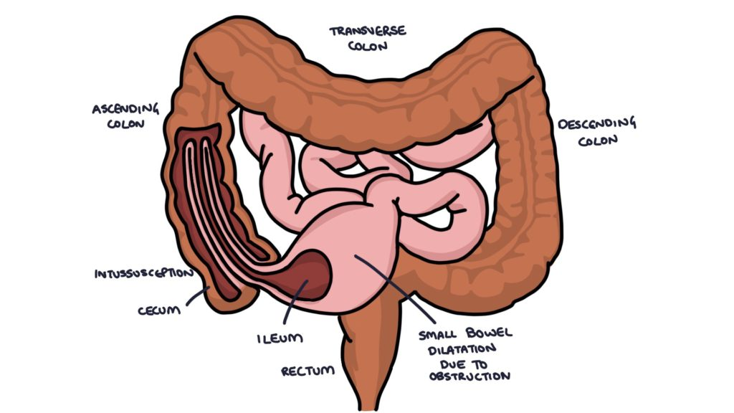
Intussusception
Medical Terminology
Intus-: Prefix meaning "within" or "inward".
Susceptio / Suscipere: Root/suffix meaning "to take up," "catch," or "receive" (from sub- meaning "from under" + capere meaning "to take")

Slide 125
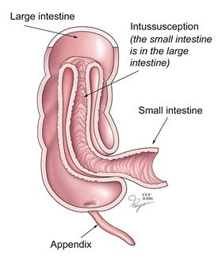
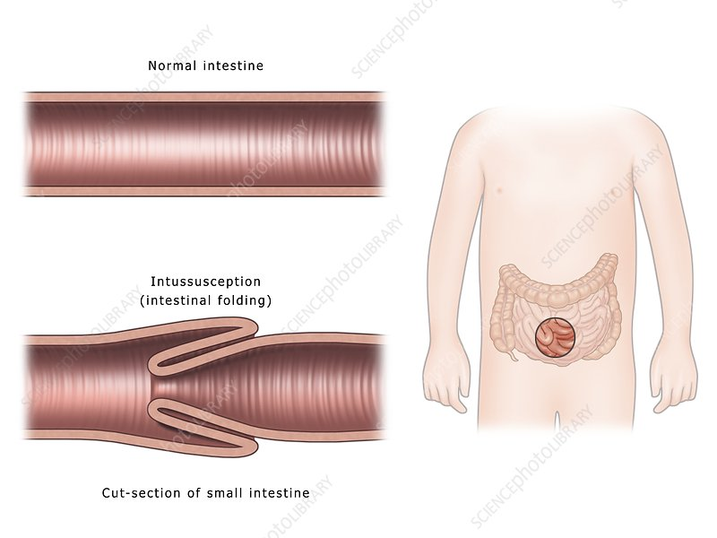
Intussusception
telescoping of one segment of bowel (intussusceptum) into the lumen of an adjacent segment (intussuscipiens)
it is one of the most common causes of intestinal obstruction in infants and young children.

Slide 126
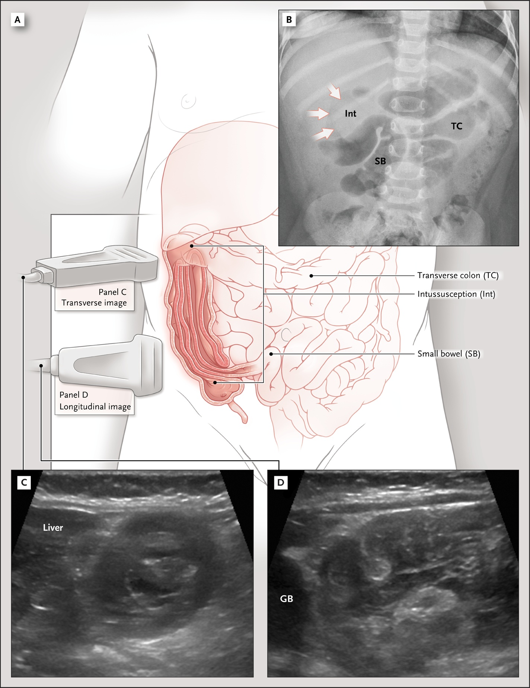
Abdominal Imaging of the Intussusception

Slide 127
Epidemiology & Risk Factors
Peak age: 5–9 months, with most cases occurring between 3 months and 5 years
Boys are affected 2–8 times more often than girls
Incidence: approximately 35 per 100,000 infants
75% of ileocolic intussusceptions are idiopathic; the remainder are associated with a pathologic lead point (10–25%)
Viral infections (especially adenovirus and HHV-6) are associated with intussusception, likely through lymphoid hyperplasia acting as a trigger

Slide 128
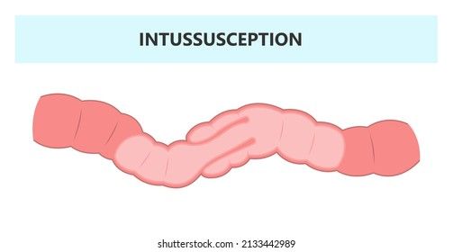
Epidemiology & Risk Factors
Common Lead Points (Causes):
Lymphoid Hyperplasia (Most Common): Following a viral or bacterial infection, Swollen immune tissue creates a bump that normal gut movements catch and pull forward.
Meckel's Diverticulum: A small pouch from fetal development that gets caught by gut contractions and dragged inward.
Intestinal Polyps: Hanging growths that gut movements snag, pulling them and their base downstream.
Duplication Cysts: Fluid-filled birth defects that create a physical lump, getting caught and pulled forward.
Lymphoma: A bulky tumor in the gut wall that gets caught and pulled into the next segment.

Slide 129
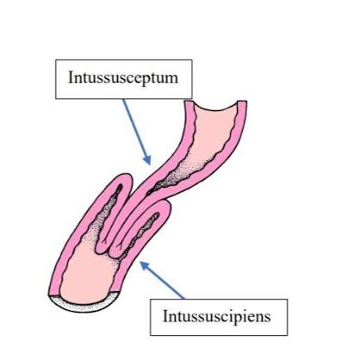
Pathophysiology
The intussusceptum drags its mesentery into the intussuscipiens, causing venous congestion → bowel wall edema → arterial compromise → ischemia → necrosis → perforation if untreated. The most common type is ileocolic (ileum telescopes through the ileocecal valve into the cecum/ascending colon).

Slide 130
Clinical Presentation
The classic triad — intermittent colicky abdominal pain, currant jelly stool, and palpable sausage-shaped mass
Most common symptoms: intermittent, episodic abdominal pain/irritability (>90%), vomiting (often nonbilious initially, ~70%), and bloody stools
Children <12 months are more likely to present with emesis, irritability, and guaiac-positive/grossly bloody stools
***High-yield pearl: Young infants can present atypically with lethargy or altered mental status — intussusception should be on the differential for unexplained lethargy in an infant even without classic GI symptoms

Slide 131
Diagnosis
Ultrasound is the diagnostic modality of choice — sensitivity >98%, specificity 88–100% [9-10]
Classic findings: "target sign/doughnut sign" on transverse view; "pseudo-kidney sign" on longitudinal view
Abdominal radiographs are less sensitive but may show absence of gas in the right lower quadrant/ascending colon, a soft-tissue mass, or signs of obstruction/perforation

Slide 132
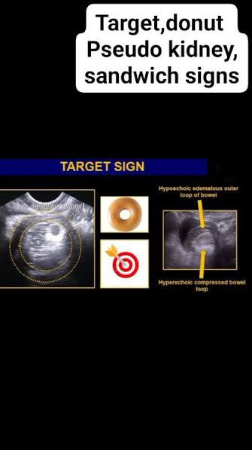
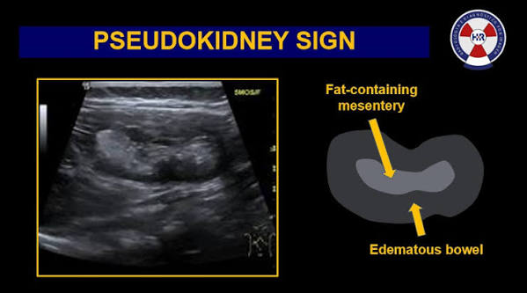
Diagnosis
Target/Donut Sign
Pseudokidney Sign

Slide 133
Management
This is a medical/surgical emergency — delay increases risk of surgical intervention and mortality
First-line treatment: non-operative enema reduction (pneumatic with air or hydrostatic with saline/contrast) in hemodynamically stable patients without perforation
Air (pneumatic) enema is generally preferred — faster reduction, lower radiation exposure, and fewer complications if perforation occurs
Pressure maintained at 80–120 mmHg; the "rule of threes" — if no progress after three 5-minute attempts, reduction is likely unsuccessful
Success rate approximately 66–71%
If tension pneumoperitoneum occurs, immediate needle decompression at the midline infraumbilical location

Slide 134
Management continued
Recurrence rate after successful non-operative reduction: approximately 5–9%
Dexamethasone may reduce recurrence rates
Surgical intervention (laparotomy or laparoscopy with manual reduction ± bowel resection) is indicated when:
Patient is hemodynamically unstable or peritonitic
Evidence of perforation
Failed enema reduction
Identified pathologic lead point
Discharge criteria after successful reduction: tolerating clear fluids, asymptomatic, with return precautions for recurrence

Slide 135
***Pearls***
Intussusception in a child >5 years → think pathologic lead point (lymphoma, polyp, Meckel's)
Lethargy in an infant with no clear etiology → consider intussusception
Currant jelly stool = blood mixed with mucus from mucosal sloughing (late finding)
Most common location = ileocolic
Best initial test = ultrasound (target sign)
Best initial treatment = air enema reduction
Contraindication to enema reduction = perforation, peritonitis, hemodynamic instability

Slide 136
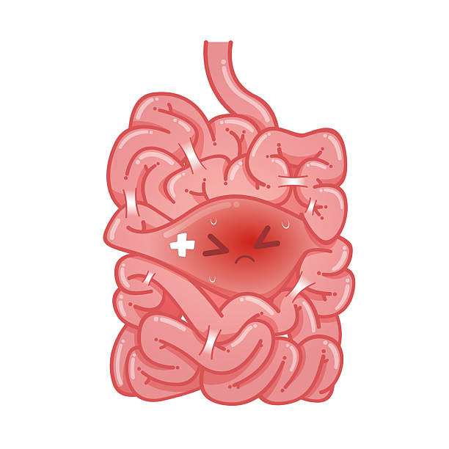
Obstruction
Small Bowel Obstruction (SBO)

Slide 137
Small Bowel Obstruction (SBO)
Epidemiology
SBO accounts for approximately 15% of acute surgical GI admissions, with ~350,000 cases annually in the United States.
Etiology
Adhesions — 65% (most common cause overall; prior abdominal surgery is the #1 risk factor)
Hernias — 10% (incarcerated inguinal, ventral, or internal hernias; highest strangulation rate at ~33%)
Neoplasms — 5%
Crohn's disease — 5%
Other (volvulus, gallstone ileus, intussusception, strictures, foreign bodies) — 15%
A special population to remember: patients with prior Roux-en-Y gastric bypass are at high risk for closed-loop obstruction from internal hernias and may not present with classic signs.

Slide 138
Pathophysiology
Mechanical obstruction → proximal bowel dilation (primarily from swallowed air and accumulated secretions) → increased intraluminal pressure → decreased mucosal perfusion → bacterial overgrowth → risk of ischemia, strangulation, and perforation.
Bowel ischemia increases mortality from ~3% to 30%.

Slide 139
Step by Step Breakdown
The Blockage Starts
A mechanical obstruction physically blocks the intestine, stopping food, fluid, and gas from moving forward.
Fluid and Air Build Up
Because things can't pass, the intestine above the blockage (proximal bowel) swells up from swallowed air and digestive fluids.
Pressure Rises
This buildup creates increased intraluminal pressure (high pressure inside the gut), which squeezes the walls of the intestine.
Blood Flow Drops
The squeezing cuts off healthy blood flow to the intestinal lining (decreased mucosal perfusion).
Bacteria Multiply
With poor blood flow and trapped contents, bacteria rapidly multiply (bacterial overgrowth).
Severe Damage and Danger
The lack of blood and heavy pressure put the intestine at high risk of tissue death (ischemia), twisting/cutting off blood entirely (strangulation), or bursting open (perforation).

Slide 140
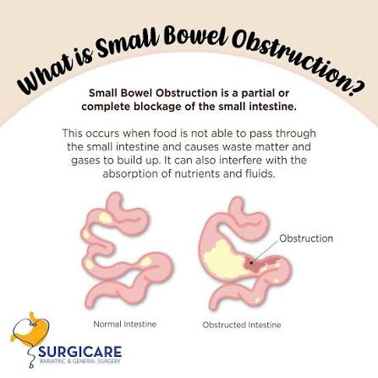
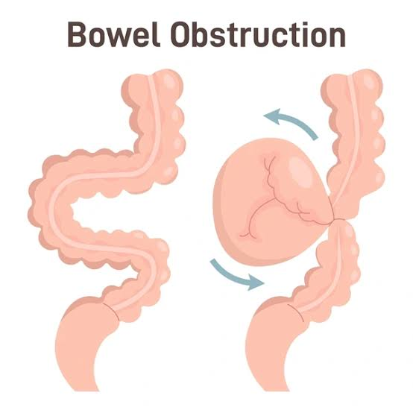
SBO

Slide 141
Clinical Presentation — The Classic Tetrad
Colicky abdominal pain (intermittent, crampy; becomes constant when peristalsis ceases)
Nausea and vomiting (bilious = distal to ampulla of Vater; feculent = distal or long-standing obstruction)
Abdominal distension
Obstipation/constipation

Slide 142
Physical exam findings
Tympany to percussion, abdominal distension
High-pitched "tinkling" bowel sounds early → absent bowel sounds late (neither sensitive nor specific)
Red flags for strangulation/ischemia: fever, tachycardia, hypotension, involuntary guarding, rebound tenderness, abdominal rigidity

Slide 143
Key Distinctions to Understand
Classification | Definition | Clinical Significance
Partial vs. Complete | Partial allows some passage of gas/fluid; complete does not | Complete obstruction has higher surgical rates and strangulation risk
Simple vs. Complicated | Simple = no vascular compromise; Complicated = ischemia, strangulation, or perforation | Complicated SBO requires urgent surgery
Closed-loop obstruction | Bowel obstructed at two points, trapping a segment | Surgical emergency — high risk of rapid ischemia; will not resolve nonoperatively

Slide 144
Diagnosis
Labs: CBC (leukocytosis, bandemia), BMP (electrolyte derangements, AKI from dehydration), lactate (elevated suggests ischemia), lipase (to rule out pancreatitis)

Slide 145
Imaging
Abdominal X-ray (KUB): May show dilated loops of small bowel with air-fluid levels on upright film, but cannot exclude SBO — sensitivity is limited
CT abdomen/pelvis with IV contrast is the gold standard — highly sensitive and specific for detecting the site, cause, and severity of obstruction. Key CT findings include:
Dilated proximal bowel (>3 cm) with decompressed distal bowel
Transition point (where dilated meets collapsed bowel)
Signs of ischemia: decreased/absent bowel wall enhancement, wall thickening, mesenteric edema, ascites, pneumatosis intestinalis (gas or air in wall of small or large intestine), portal venous gas
Small bowel feces sign — particulate matter in dilated small bowel; its absence may predict need for surgery

Slide 146


Small Bowel Feces Sign

Slide 147

Gaseous distention of small bowel loops with no gas in colon or rectum
Notes:
Plain film

Slide 148
Management
Nonoperative (successful in ~65–80% of cases, especially partial SBO):
NPO-Nothing by Mouth (bowel rest)
IV fluid resuscitation and electrolyte correction
Nasogastric tube (NGT) decompression — relieves distension and vomiting
Surgery to be consulted
Gastrografin (water-soluble contrast): Both diagnostic and therapeutic; if contrast reaches the colon on follow-up X-ray (typically at 8–24 hours), nonoperative management is likely to succeed
Serial abdominal exams and labs to monitor for deterioration
Most patients improve within 2–5 days; failure to improve by 3–5 days suggests need for surgery

Slide 149
Indications for Surgery
Peritonitis or signs of bowel strangulation/ischemia
Closed-loop obstruction
Irreducible hernia
Complete obstruction that fails to resolve
Failure of nonoperative management (persistent pain, no return of bowel function, high NGT output >500 mL after 72 hours)

Slide 150
Differential Diagnosis
Paralytic (adynamic) ileus (post-op, medications, electrolyte abnormalities)
Large bowel obstruction
Colonic pseudo-obstruction (Ogilvie syndrome)
Mesenteric ischemia
Narcotic bowel
The key differentiator: SBO is a mechanical obstruction with a transition point, whereas ileus involves diffusely dilated bowel without a transition point.

Slide 151
Mortality
Uncomplicated SBO: ~3–10%
SBO with bowel necrosis/perforation: up to 30%
Delay in treatment >24 hours is independently associated with increased death and complications

Slide 152

Polyps

Slide 153
Overview
Despite the small bowel comprising 90% of the GI mucosal surface area, it accounts for only ~3% of GI tract tumors.
Small bowel polyps are most clinically significant in the context of hereditary polyposis syndromes,
Sporadic benign lesions (lipomas, leiomyomas, neurofibromas, adenomas) also occur but are far less commonly tested.

Slide 154
Key Polyposis Syndromes Involving the Small Bowel
Syndrome | Gene (Inheritance) | Polyp Type | Key Clinical Features | Cancer Risk
Peutz-Jeghers (PJS) | STK11 (AD) | Hamartomatous (arborizing smooth muscle bands) | Mucocutaneous pigmentation (lips, buccal mucosa); small bowel intussusception | 93% lifetime any cancer; small bowel 13%, CRC 39%, breast 54%, pancreas 11–36%
Familial Adenomatous Polyposis (FAP) | APC (AD) | Adenomatous | >100 colonic adenomas; duodenal adenomas common; desmoid tumors, CHRPE, osteomas | CRC ~100% untreated; duodenal cancer <1–10%
Juvenile Polyposis (JPS) | SMAD4 or BMPR1A (AD) | Juvenile (inflammatory) | GI bleeding, anemia in childhood; SMAD4 carriers → HHT overlap | CRC up to 39–68%; gastric cancer (esp. SMAD4)
Cowden / PTEN Hamartoma Tumor Syndrome | PTEN (AD) | Hamartomas, ganglioneuromas, mixed | Macrocephaly, trichilemmomas, oral papillomas, Lhermitte-Duclos disease | Breast, thyroid, endometrial, renal, CRC
Notes:
PTEN (Tumor Suppressor Gene)

Slide 155

Peutz-Jeghers Syndrome
PJS is the prototype for small bowel polyposis.
autosomal dominant disorder caused by a mutation in the STK11 gene
Key points:
Mucocutaneous pigmentation (dark blue/brown macules on lips, buccal mucosa, perioral area, hands, feet) is present in >95% of patients and often appears in infancy before GI symptoms.
Small bowel polyps are present in 75% of cases, most commonly in the jejunum > ileum > duodenum. Histologically, PJ polyps show a characteristic arborizing pattern of muscularis mucosae running through the lamina propria, covered by hyperplastic glandular mucosa.
The most feared complication is intussusception — by age 20, approximately half of PJS patients will present with small bowel obstruction from intussusception. Polyps >15 mm should be treated to prevent this.
Cancer risk is extraordinary: the absolute risk of developing any cancer between ages 15 and 64 is estimated at 93%, with a relative risk of 15.2 for any cancer. The small intestine has the highest relative risk (RR 520) of any organ
Surveillance begins at age 8 with EGD, colonoscopy, and small bowel imaging (capsule endoscopy or MR enterography), repeated every 2–3 years.

Slide 156
Familial Adenomatous Polyposis (FAP) and the Small Bowel
Duodenal adenomas occur in the majority of FAP patients and represent the leading cause of cancer death after prophylactic colectomy.
Jejunal and ileal polyps in FAP also carry malignant potential via the adenoma-carcinoma sequence
Require periodic surveillance and endoscopic resection.

Slide 157

Polyposis syndromes
Notes:
What the inside lumen looks like when scoped

Slide 158
Clinical Presentation of Small Bowel Polyps (All Causes)
GI bleeding (occult or overt) with iron deficiency anemia — most common presentation
Abdominal pain and distention
Intussusception and bowel obstruction (especially PJS)
Many small bowel polyps are asymptomatic and discovered incidentally or during surveillance

Slide 159
Diagnosis and Management
Capsule endoscopy is the primary noninvasive modality for small bowel visualization
MR enterography is complementary, with similar diagnostic yield for lesions ≥15 mm
Double-balloon enteroscopy (DBE) allows both diagnosis and therapeutic polypectomy throughout the entire small bowel, and has largely replaced surgical resection as first-line management
Small bowel polyps ≥10 mm in PJS should be removed to prevent intussusception
In FAP, the recommendation is for resection of every adenoma >1 cm
When surgery is required (e.g., intussusception), a "clean sweep" approach with intraoperative enteroscopy to remove all polyps decreases the need for repeat surgery

Slide 160
***Pearls***
Dark macules crossing the vermillion border of the lip + small bowel intussusception in a young patient = Peutz-Jeghers syndrome (STK11-gene)
Hamartomatous polyp with arborizing smooth muscle = PJ polyp
SMAD4 mutation + juvenile polyps + epistaxis/telangiectasias = JPS-HHT overlap
Duodenal adenomas in a patient with known FAP = leading cause of cancer death post-colectomy

Slide 161
Closing Time

Slide 162
Mystery Case
Ms. Riding Hood, symptoms included having burning epigastric abd pain, nausea, vomiting, bloating, early satiety,coffee ground emesis, black tarry stools 6 days ago. Now her pain has radiated to her RLQ and her temp is now 102.3 F and she is still very nauseous and is vomiting.
Who can tell me all of her diagnosis?

Slide 163
Mystery Case
Assessment:
1)Gastritis
2)GI Bleed (UGIB)
3) Appendicitis

Slide 164
Mystery Case
Treatment Plans
1. Gastritis
Remove Triggers: Discontinue offending agents like NSAIDs, alcohol, and spicy foods.
Acid Suppression: Initiate a Proton Pump Inhibitor (PPI) (e.g., omeprazole) or an H2 blocker (e.g., famotidine) to promote mucosal healing.
Infection Control: Test and treat for H. pylori if positive (using a multi-drug regimen of antibiotics and a PPI).
2. Upper Gastrointestinal Bleed (UGIB)
Resuscitation: Stabilize the patient with large-bore IV access, aggressive fluid resuscitation, and blood transfusions if hemodynamically unstable.
Medical Therapy: Start a high-dose IV Proton Pump Inhibitor (PPI) infusion.
Intervention: Perform an urgent esophagogastroduodenoscopy (EGD) within 24 hours to locate and treat the bleeding source (via banding, cautery, or clipping).
3. Appendicitis
Surgical Intervention: Perform an urgent appendectomy (laparoscopic is preferred), which is the definitive treatment.
Preoperative Care: Administer IV broad-spectrum antibiotics and IV fluid resuscitation.
Non-Surgical Alternative: In select uncomplicated cases without an appendicolith, targeted IV antibiotics may be used, though appendectomy remains the gold standard to prevent recurrence.

Slide 165
PANCE Question
A 28-year-old female presents to the emergency department complaining of right lower quadrant abdominal pain that has been present for the past 5 days. She has experienced anorexia, nausea, and subjective fevers.
On PE, her temperature is 38.6°C (101.5°F), heart rate is 108 bpm, and blood pressure is 112/74 mmHg. Abdominal examination reveals a tender palpable, firm mass in the right lower quadrant with localized guarding.
A CT scan of the abdomen and pelvis with IV contrast demonstrates a ruptured appendix with a well-circumscribed, 5.0 cm periappendiceal abscess.

Slide 166
Which of the following is the most appropriate initial management for this patient?
A) Immediate open appendectomy
B) Immediate laparoscopic appendectomy
C) Intravenous antibiotics and CT-guided percutaneous drainage
D) Diagnostic laparoscopy with extensive peritoneal lavage
E) Discharge home with a 14-day course of oral antibiotics

Slide 167
PANCE Answer Reveal and Explanation
Correct Answer: C) Intravenous antibiotics and CT-guided percutaneous drainage
Rationale
The Clinical Scenario: The patient is presenting with a late/delayed presentation of acute appendicitis (symptoms for 5 days) complicated by perforation and a large, contained periappendiceal abscess.
Why C is correct: For a ruptured appendix complicated by a well-contained abscess that is accessible and larger than 3-4 cm, the standard of care is non-operative initial management. This consists of bowel rest, broad-spectrum intravenous antibiotics, and percutaneous image-guided (usually CT or ultrasound) drainage. Immediate surgery in the setting of significant inflammation and abscess formation carries a high risk of complications, including bowel injury, extensive adhesion formation, and the potential need for an ileocecectomy or right hemicolectomy. Once the inflammation subsides (usually 6 to 8 weeks later), an interval appendectomy may be performed to prevent recurrence.

Slide 168
Why the other options are incorrect
A & B (Immediate appendectomy): While immediate surgical resection (usually laparoscopic) is the gold standard for uncomplicated acute appendicitis or generalized peritonitis secondary to a ruptured appendix, it is contraindicated as the initial step for a stable patient with a delayed presentation and a large, discrete, drainable abscess.
D (Diagnostic laparoscopy with lavage): This is an unnecessary and overly invasive initial step given the clear CT diagnosis of a localized abscess that can be managed percutaneously.
E (Discharge on oral antibiotics): While oral antibiotics might be used down the line or for highly selected, uncomplicated, mild cases in certain non-operative protocols, a patient with a 5.0 cm intra-abdominal abscess and systemic signs of infection (tachycardia, fever) requires admission, IV antibiotics, and drainage.

Slide 169

Landing the Plane
Key Points
Review the lecture materials corresponding to each disease entity
To optimize your study efficiency and deepen your understanding, review your prior GI Mechanisms of Disease lectures for a targeted review of relevant anatomy and physiology as needed.
Be sure to know the Pearls of today’s lecture for they are PANCE specific.
Use this slide to study. The core content is the same as the student version posted but this slide has some minor updates and has the questions you may want to review!
Looking Ahead
Module N/Week 13: GI Disorders

Slide 170
GI Homework Questions
BONUS!!!

Slide 171
Homework GI Question #1
A 45-year-old man presents to the emergency department complaining of sharp, burning epigastric pain that wakes him up at night. He reports that the pain is temporarily relieved by eating food or taking over-the-counter antacids, but worsens 2 to 3 hours after a meal. Over the past 24 hours, he has experienced two episodes of dark, tarry stools. He admits to taking high-dose ibuprofen daily for chronic lower back pain. An esophagogastroduodenoscopy (EGD) reveals a 1.5 cm ulcer on the anterior wall of the duodenal bulb.
What is the most appropriate next step in the management of this patient's underlying condition and why?

Slide 172
Homework GI Question #2
A 58-year-old male presents to the gastroenterology clinic complaining of persistent, burning epigastric pain that wakes him up at night, along with intermittent nausea and dark, tarry stools over the past week. Upper endoscopy (EGD) reveals a 1.5 cm sharply demarcated ulcer in the duodenal bulb. Rapid urease testing performed on mucosal biopsies is positive for Helicobacter pylori.
The patient reports a severe, documented anaphylactic allergy to penicillin (hives and shortness of breath).
What is the most appropriate initial eradication regimen for this patient and why?

Slide 173
References
1.Global, Regional, and National Burden of Gastritis and Duodenitis From 1990 to 2021 With Projections to 2050: A Systematic Analysis of the Global Burden of Disease Study 2021.
International Journal of Medical Sciences. 2025. Wang L, Jiang W, Li H.
2.Global Incidence and Prevalence of Gastritis and Duodenitis From 1990 to 2019: A Systematic Analysis for the Global Burden of Disease Study 2019.
Journal of Gastroenterology and Hepatology. 2024. Xu Y, Chen F, Wen H.

